Slide 1
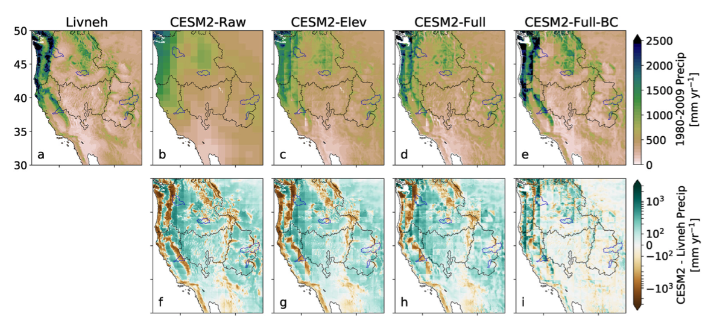
Mass-Conserving Downscaling of Climate Model Precipitation Over Mountainous Terrain for Water Resource Applications
A. Rugg, E. D. Gutmann, R. R. McCrary, F. Lehner, A. J. Newman , J. H. Richter, M. R. Tye, A. W. Wood:
Geophysical Research Letters (2023) doi: 10.1029/2023GL105326
OBJECTIVE
Climate model output often needs to be downscaled to be useable in hydrologic and other impact studies, especially over mountainous terrain. The goal here is to develop a computationally cheap but effective way to achieve this.
APPROACH
We use information on sub-grid scale topography and 700mb wind direction statistics together with standard bias correction methods to downscale precipitation and temperature from CESM2 over the Western US.
IMPACT
Using results from this downscaling in a hydrologic model, we show that runoff simulations are also improved, making this a viable tool to create more actionable water resource-related information from climate models.
Fig. 2 from Rugg et al. (2023), showing various versions of the downscaling method for 1980-2009 water year precipitation from observations and CESM2. The upshot is that in many mountainous regions climate model bias correction (BC) is more important than the choice of downscaling method to bring model output closer to observations.

