Slide 1
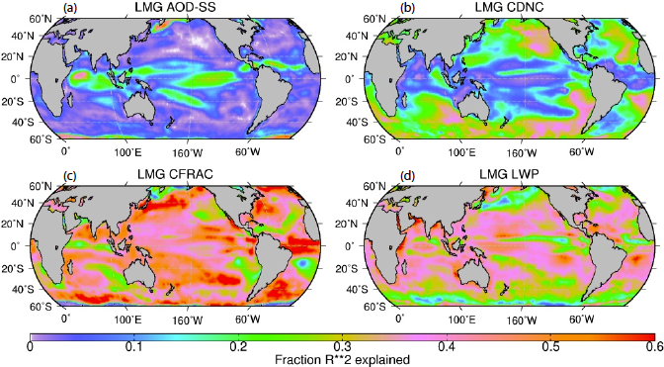
The Influence of Sea Salt Variability on Clouds
Objective
To understand role of sea salt variability in climate variability
Approach
Perform 150-year coupled climate simulations with and without interactive sea salt
Determine spatial and temporal distributions of modes of variability of clouds and aerosol
Quantify the contribution of sea salt variability to variability in cloud radiative forcing
Fraction of variance of cloud radiative forcing explained by (a) sea salt optical depth (AOD-SS), (b) cloud droplet number concentration (CDNC), (c) cloud fraction (CFRAC), and (d) cloud liquid water path (LWP)
Impact
Sea salt variability driven by winds produces 20-30% of the variance of cloud radiative forcing in the tropics
Xu L, DW Pierce, LM Russell, AJ Miller, RCJ Somerville, CH Twohy, SJ Ghan, B Singh, JH Yoon and PJ Rasch. 2015. “Interannual to Decadal Climate Variability of Sea Salt Aerosols in the Coupled Model CESM1.0.” Journal of Geophysical Research: Atmospheres accepted. DOI:10.1002/2014JD022888.
Notes:
http://www.pnnl.gov/science/highlights/highlightsasp?division=749

