Slide 1
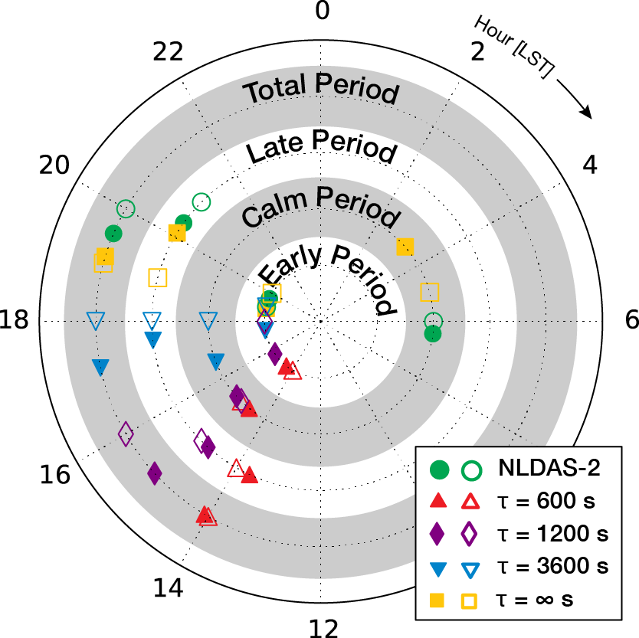
Springtime Precipitation Biases in CAM5 Physics Remain with Mesoscale Resolutions for the Central U.S.
Objective
To test convective timescale choice in the Zhang-McFarlane convective parameterization at a resolution anticipated in the global Community Atmosphere Model (CAM5) in the coming years (Δx=32 km)
Hour of peak precipitation for composited diurnal cycles over the central U.S. during sub-periods of MC3E. The observed (NLDAS-2) diurnal peak is compared to different convective timescale choices (𝛕) with the Zhang-McFarlane deep convection parameterization. Open vs. closed symbols depict different methodologies for determining the peak.
Approach
Use the CAM5 physics suite in the Weather Research and Forecasting model to test parametric sensitivity of the the resolution-dependent convective timescale
Simulate the MC3E field campaign period over the central U.S. to capture springtime and early summer weather conditions
Impact
Similar precipitation diurnal cycle dependencies occur in the regional model, with its constrained lateral boundary conditions, as have been seen in global models
Longer convective timescales move peak precipitation later in the day (closer to the observed time), but result in an overall low bias for rain amount
Rain amount is most accurate with a shorter convective timescale for this resolution, location, and time of year.
Gustafson WI, P-L Ma, B Singh. 2014. “Precipitation Characteristics of CAM5 Physics at Mesoscale Resolution During MC3E and the Impact of Convective Timescale Choice.” Journal of Advances in Modeling Earth Systems 6: 1271-1287. DOI: 10.1002/2014MS000334
Notes:
http://www.pnnl.gov/science/highlights/highlights.asp?division=749

