Slide 1
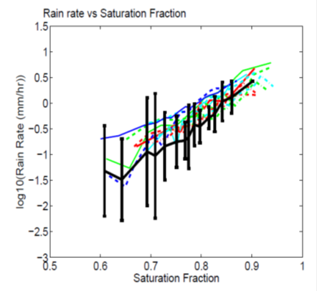
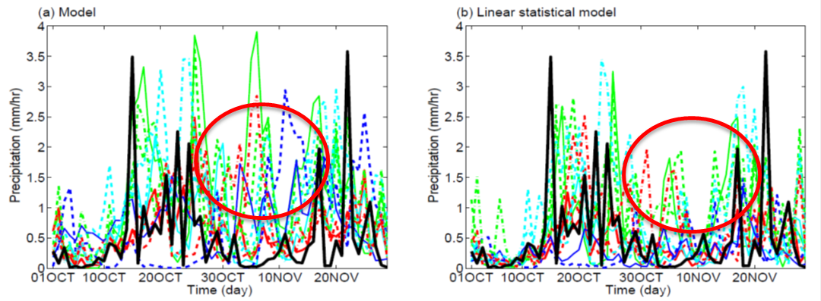
Simulating the MJO Requires Capturing the Relationship Between Environmental Moisture and Precipitation
Objective
Examine the causes of model biases in the simulation of Madden-Julian Oscillation (MJO) observed during AMIE/DYNAMO field campaign
Approach
Perform eleven regional and global model simulations with parameterizations as well as explicit representation of convection
Quantify the effects of biases in the relationships between humidity and precipitation, between evaporation and surface winds and between humidity and cloud radiative forcing.
LEFT: Relationship between rain rate and column moisture observed during AMIE/DYNAMO (black), model simulations (colors).
BOTTOM: Time series of rain rate (a) original and (b) after accounting for the relationship bias using a linear statistical model.
Impact
The simulations tend to produce more precipitation than is observed especially at low-saturation fraction values and during suppressed phase of the MJO.
The bias in the relationship between precipitation and moisture saturation fraction accounts for up to 30% of the total precipitation bias.
Hagos SM, Z Feng, CD Burleyson, C Zhao, MN Martini, and LK Berg. 2015. “Moist Process Biases in Simulations of the Madden-Julian Oscillation Episodes Observed during the AMIE/ DYNAMO Field Campaign.” Journal of Climate 29(3): 1091-1107. DOI: 10.1175/JCLI-D-15-0349.1
Notes:
http://www.pnnl.gov/science/highlights/highlights.asp?division=749

