Slide 1
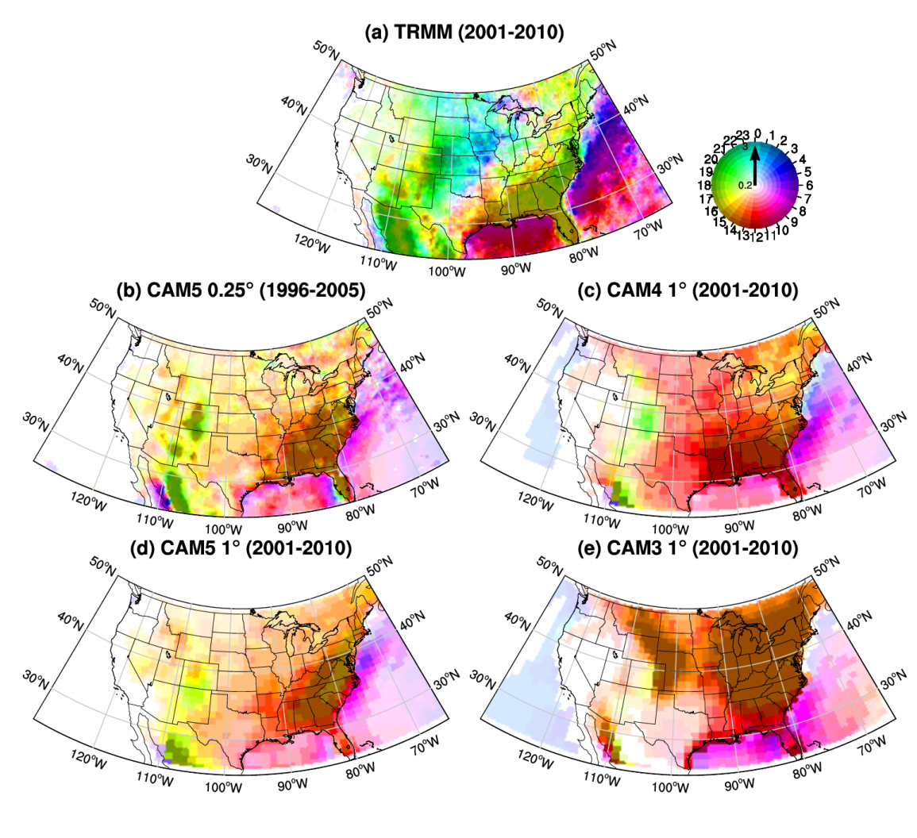
How Well Are the Distribution and Extreme Values of Daily Precipitation over North America Represented in the Community Climate System Model? A Comparison to Reanalysis, Satellite, and Gridded Station Data
Gervais M., J. R. Gyakum, E. Atallah, L. B. Tremblay and R. B. Neale, 2014:. J. Climate, 27, 5219–5239.
OBJECTIVE
To examine the distribution and extreme values of daily precipitation over North America. GCM model versions and observation-based datasets were examined in order to determine model utility for future climate studies of extreme events changes.
APPROACH
Extreme daily precipitation events in versions 3 through 5 of the Community Atmosphere Model (CAM) and at different resolutions are compared to several observation-based data products. These independent data products include gridded station, satellite and reanalysis product and provide a quantitative measure of observational error.
IMPACT
This study shows that the nature of extreme event statistics model errors varies across North America. In CAM precipitation is more positively skewed (too many light events) to the East of the Rocky Mountains. Over the Rocky Mountains too much precipitation and a poor diurnal cycle lead to the opposite bias with too few light rain events. In general extreme events tend to be underestimated in regions and time periods with strong convective precipitation. This is strongly tied to the parameterization of convection across model versions. Importantly, comparison across the different datasets shows the observational errors to be approaching the magnitude seen in CAM. This shows the importance of addressing disparity among observational data products.
Local time of first harmonic of Jul-Aug diurnal precipitation (color hue) in the (a) TRMM, (b) CAM5 at 0.25°, (c) CAM4 at 1°, (d) CAM5 at 1°, and (e) CAM3 at 1°. Color intensity represents the mean daily precipitation (mm day−1) beginning at 0.2 mm day−1. The observation period is 2001–10, except the CAM5 at 0.25°, where it is 1996–2005.

