Slide 1
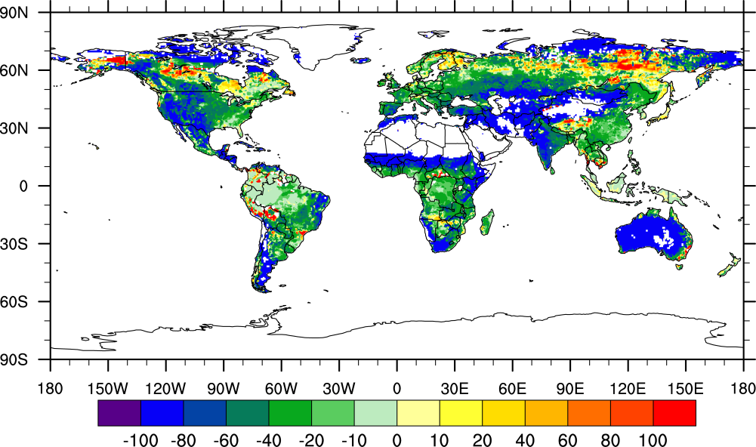
Sensitivity of Global Terrestrial Gross Primary Production to Hydrologic States
Objective
Evaluate effects of hydrologic states on global gross primary production simulated by land surface models, and analyze the pathways for how uncertainty in representing runoff generation leads to carbon flux uncertainty in models
Approach
Run two CLM4 simulations with TOPMODEL-based and VIC-based runoff generation parameterizations to illustrate how changes in hydrologic processes influence carbon cycle simulations
Evaluate the simulations against observations and determine how changes in soil moisture and temperature influence terrestrial gross primary production
Relative difference in gross primary production: -20.4% (CLM4VIC-CLM4)
Impact
Structural differences in the runoff generation parameterization alone can lead to large uncertainty in carbon cycle modeling through effects of directly modulating soil moisture availability and indirectly altering vegetation phenology responding to water and temperature stressors
Demonstrated significant interactions among the water, energy, and carbon cycles, and the need to reduce uncertainty in the land surface model hydrologic parameterizations to better constrain carbon cycle modeling.
Lei H, M Huang, LR Leung, D Yang, X Shi, J Mao, DJ Hayes, CR Schwalm, Y Wei, S Liu. 2014. “Sensitivity of Global Terrestrial Gross Primary Production to Hydrologic States Simulated by the Community Land Model using Two Runoff Parameterizations.” Journal of Advances in Modeling Earth Systems, DOI: 10.1002/2013MS000252.
Notes:
http://www.pnnl.gov/science/highlights/highlights.asp?division=749

