Slide 1
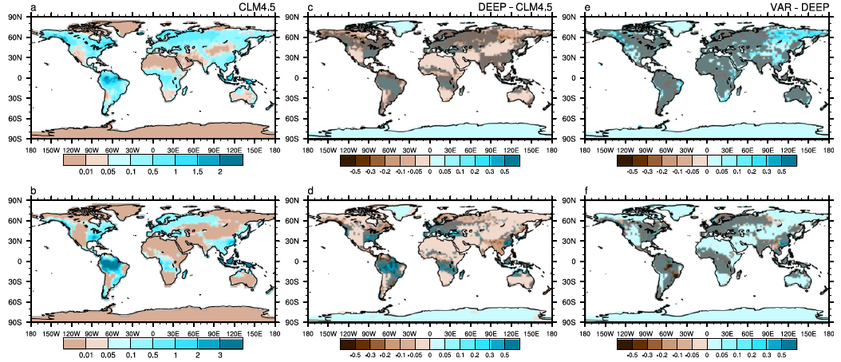
Implementing and Evaluating Variable Soil Thickness in the Community Land Model, Version 4.5 (CLM45)
Right panels: Using variable soil thickness has larger impacts on base-flow (bottom) than surface runoff (top) (shaded areas are not statistically significant)
Objective
Introduce variable soil thickness in Community Land Model (CLM45) and evaluate the effects on the land surface simulations
Approach
Implement variable soil thickness in CLM45 using information from global bedrock depth data
Perform sensitivity experiments to compare simulations with shallow and deep soil column of constant depths with simulations using variable soil thickness
Analyze simulated surface and subsurface hydrology and surface fluxes to evaluate the effects of variable soil thickness
Impact
One of the recognized weaknesses of land-surface models used in weather and climate models is the assumption of constant soil thickness
Using a global dataset for the thickness of bedrock, spatial variation in soil thickness is included for the first time in the Community Land Model. The implementation of variable soil thickness represents a step forward in land-surface model development.
Brunke, MA P Broxton, J Pelletier, D Gochis, P Hazenberg, D Lawrence, L R Leung, G-Y Niu, P Troch, and X Zeng, 2016. “Implementing and Testing Variable Soil Thickness in the Community Land Model Version 4.5.” Journal of Climate 29. DOI: 101175/JCLI-D-15-03071
Notes:
http://www.pnnl.gov/science/highlights/highlights.asp?division=749

