Slide 1
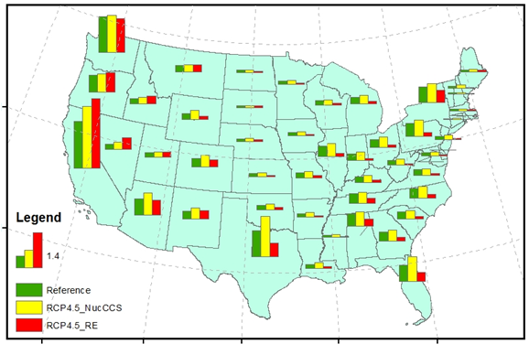
U.S. Water Demands for Electricity Generation
Objective
What are the interactions between the U.S. electricity and water systems? What are the impacts of key factors including water-saving adaptations, climate mitigation policies, capital stock turnover, and technological advances?
Approach
Employed an integrated modeling approach (GCAM-USA) that captures energy–water interactions at regional and national scales
Developed detailed scenarios of the future generation portfolio and cooling technology mix
Estimated future state-level electricity generation and associated water withdrawals and consumption under different scenarios
GCAM-USA’s estimates of the state level electric-sector water consumption under the Reference, RCP4.5_NucCCS and RCP4.5_RE scenarios in 2095
Impact
Climate mitigation strategies that encourage renewable energy reduce water consumption compared to strategies focused on carbon capture and storage and nuclear power
The geographical and technological detail of this study provides a useful platform to address scientific, policy relevant, and emerging issues at the heart of the water–energy nexus in the U.S.
Liu L, M Hejazi, P Patel, P Kyle, E Davies, Y Zhou, L Clarke, J Edmonds. 2014. “Water Demands for Electricity Generation in the U.S.: Modeling different scenarios for the water–energy nexus.” Technological Forecasting & Social Change, in press. DOI:10.1016/j.techfore.2014.11.004.
Notes:
http://www.pnnl.gov/science/highlights/highlights.asp?division=749

