Slide 1
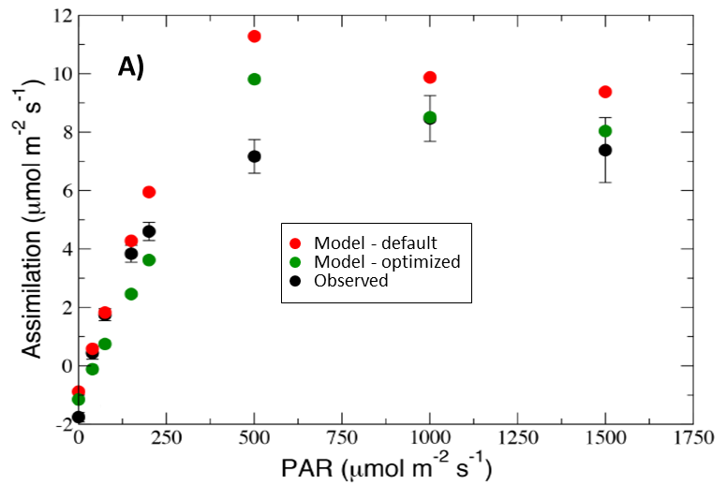
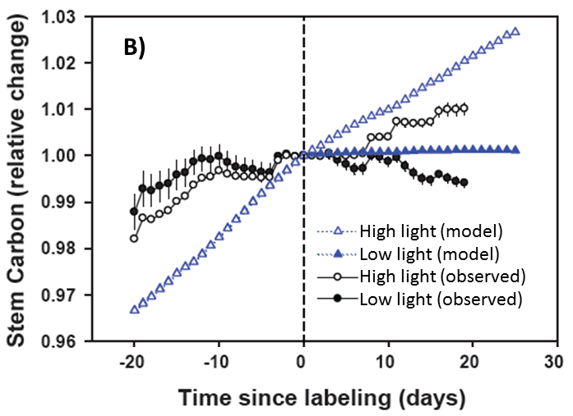
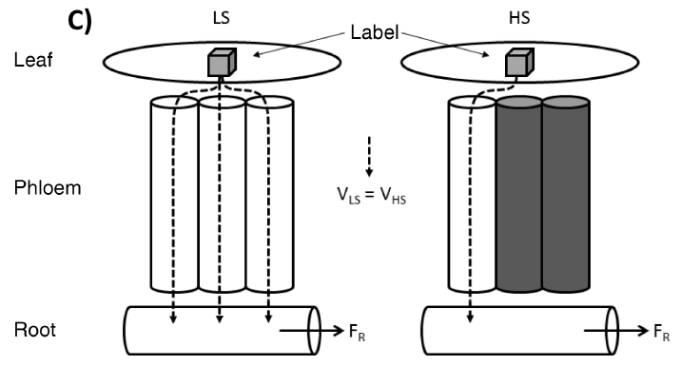
Evaluating the Community Land Model in a pine stand with shading
manipulations and ¹³CO₂ labeling
Objective
Understand the timing and magnitude of carbon fluxes through leaves, stem, roots, and soil at the PiTS site. Use carbon isotope and other data to test and improve the performance of CLM4 in capturing short-term carbon and water dynamics in response to manipulative shading treatments.
New Science
The calibrated CLM4 accurately simulates stand-level biomass, transpiration, leaf-level photosynthesis (Fig. A), and pre-labeling ¹³C values.
Over the treatment period, CLM4 generally reproduced the impacts of shading on soil moisture changes, relative change in stem carbon (Fig. B), and soil CO₂ efflux rate.
The lack of short-term carbohydrate storage pools in the model prevented it from simulating the observed timing of the carbon isotope labeling pulse as it moved from leaves through stems and roots and into the soil.
A new conceptual model of short-term photosynthate storage and transport based on the experimental observations is proposed (Fig. C).
Significance
Demonstrates the fidelity of many model processes and highlights the utility of evaluating biophysical and ecophysiological processes against targeted experimental manipulations.
Presents a new and testable hypothesis for the mechanism and dynamics of plant carbohydrate storage and transport in leaves, phloem, and roots.
Contact: Jiafu Mao, 865-576-7815, maoj@ornl.gov
Funding: DOE Office of Science, Biological and Environmental Research
Citation: J. Mao, D.M. Ricciuto, P.E. Thornton, J.M. Warren, A.W. King, X. Shi, C.M. Iversen, and R.J. Norby. Evaluating the Community Land Model in a pine stand with
shading manipulations and ¹³CO₂ labeling, Biogeosciences, 13, 641-657,
DOI: 10.5194/bg-13-641-2016.

