Slide 1
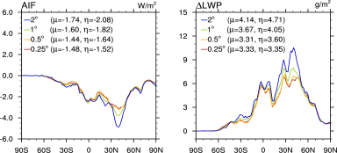
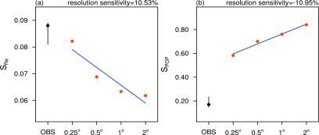
Probing Mechanisms Driving the Resolution Dependence of Aerosol Indirect Forcing
Objective
Explore the resolution sensitivity of parameterizations associated with aerosol-cloud interactions
Identify the physical mechanisms driving the sensitivity
Approach
Perform CAM5 simulations in the “nudged mode” at 4 resolutions
Use very high resolution “Year of Tropical Convection“ analysis to constrain the model meteorology
Use cloud simulator and corresponding satellite observations to evaluate model
Implement in-situ diagnostics in the model to provide process-level understanding of the resolution sensitivity
Aerosol indirect forcing from anthropogenic aerosols reduces at higher resolution.
Cloud and precipitation susceptibilities to aerosols agree better with satellite estimates at higher resolution.
Impact
Resolution sensitivity is attributed to the droplet nucleation and precipitation parameterizations
Susceptibilities of droplet size increases and precipitation probability decreases with increasing resolution, in better agreement with the satellite estimates
Ma P-L, PJ Rasch, M Wang, H Wang, SJ Ghan, RC Easter, WI Gustafson Jr., X Liu, Y Zhang, and H-Y Ma. 2015. “How Does Increasing Horizontal Resolution in a Global Climate Model Improve the Simulation of Aerosol-Cloud Interactions?” Geophysical Research Letters 42: 5058-5065. DOI:10.1002/2015GL064183.
Notes:
http://www.pnnl.gov/science/highlights/highlights.asp?division=749

