Slide 1
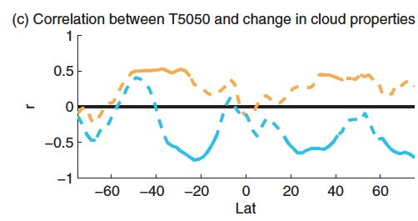
Compensation between cloud phase partitioning & cloud cover in GCMs and its implications for cloud feedback
Objective: Global climate models struggle to properly simulate the relative amounts of liquid and ice in “supercooled” clouds below freezing. Using T5050, the temperature at which ice and liquid are found in equal proportions, the authors investigate the implications of how phase is partitioned on mean state clouds and cloud feedback across 26 global climate models.
Research: In high-T5050 models, supercooled clouds contain less liquid and more ice, and hence their negative optical depth feedback is larger in magnitude due to larger transitions from ice to liquid. However, cloud cover is also larger in these models, and the positive subtropical cloud amount feedback is larger owing to larger decreases in low cloud coverage. The relationship between T5050 and cloud cover and its change under global warming are likely a result of model tuning.
Across-model correlation between T5050 and the change in (orange) in-cloud liquid water path and (blue) cloud fraction between the historical and RCP8.5 simulations, normalized by changes in local surface temperature. If the correlation coefficient is significant at 95% confidence a solid line is used.
Impact: The results suggest that the across-model compensation between subtropical amount feedback and extra-tropical optical depth feedbacks may be an artifact of model tuning. This may be artificially suppressing inter-model spread in climate sensitivity.
Reference: McCoy, D. T., I. Tan, D. L. Hartmann, M. D. Zelinka, and T. Storelvmo (2016), On the relationships among cloud cover, mixed-phase partitioning, and planetary albedo in GCMs, J. Adv. Model. Earth Syst., 8, doi:10.1002/2015MS000589.
Notes:
Compensation between cloud phase partitioning and cloud cover in GCMs and its implications for cloud feedback
Clouds at temperatures between 0°C and −40°C consist of a mixture of liquid and ice, and these two phases have different microphysical and radiative properties. Global climate models struggle to properly simulate the relative amounts of liquid and ice in such “supercooled” clouds. A simple measure of the phase partitioning is the temperature at which ice and liquid are found in equal proportions: T5050. In this study, the authors investigate the implications of the wide range of T5050 values across 26 climate models.
In models with higher T5050, supercooled clouds contain less liquid and more ice (which makes sense physically), but their cloud cover is also larger (which does not make sense given that ice crystals should precipitate more readily and decrease cloud cover). Compensation between increased ice concentrations (which decreases reflectivity) and increased cloud fraction (which increases reflectivity) leads to roughly the same amount of sunlight being reflected by all the different GCMs, and points toward model tuning as a cause. This apparent tuning also affected cloud feedbacks in the models. In high-T5050 models, the cloud optical depth feedback in regions with abundant mixed-phase clouds was more negative (which makes sense physically), but the cloud amount feedback in the subtropics was also more positive owing to larger decreases in low cloud coverage. The latter effect appears to be due to the aforementioned tuning between cloud cover and mixed-phase partitioning in the current climate. Importantly, it suggests that the across-model compensation between subtropical amount feedback and extra-tropical optical depth feedbacks -- which acts to reduce inter-model spread in climate sensitivity – may be an artifact of model tuning.

