Slide 1
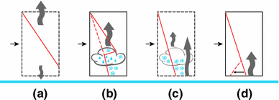
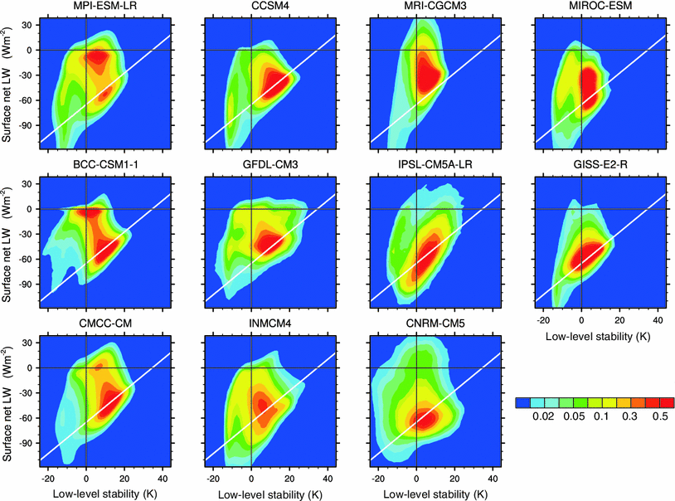
Mixed-phase clouds cause climate model biases in Arctic wintertime temperature inversions
OBJECTIVE
We show how the formation of Arctic air masses leads to the emergence of a cloudy and a clear state of the Arctic wintertime boundary layer. The cloudy state contains liquid water in the cloud, has little surface radiative cooling and inversions are elevated and weak. Surface radiative cooling leads to strong surface-based temperature inversions in the clear state. Comparing climate model output to observations, we find that most climate models lack a realistic representation of the cloudy state.
APPROACH
CMIP5 output is used to evaluate the Arctic wintertime boundary layer compared to SHEBA and ARM observations and ERA reanalyses. Single-column experiments are used to show the evolution of an idealized air mass. Several aspects of the parameterized physics are modified to show the effects on mixed-phase clouds.
IMPACT
This study exposes the origins of the bi-modal distribution of inversion strength at high latitudes. Advection of relatively warm, moist air masses from lower latitudes forms weak, elevated inversions. The boundary layer then evolves under radiative cooling. The representation of mixed-phase clouds in climate models is key to successfully modeling the two quasi-stable boundary layer states. Most models overestimate the stability of the lower-troposphere, showing that they are unable to capture the cloudy boundary layer state frequently enough.
Sketch of the formation of Arctic air. Dashed boxes mark unstable transition states
Bivariate pdfs of NDJF low-level stability and surface net longwave radiation from CMIP5 models, 6-hourly values from the ocean area north of 64 °N for 1990–1999 of the historical runs
Pithan, F., B. Medeiros, and T. Mauritsen, 2013: Mixed-phase clouds cause climate model biases in Arctic wintertime temperature inversions.
Climate Dynamics, 15 pp., doi:10.1007/s00382-013-1964-9.

