Slide 1
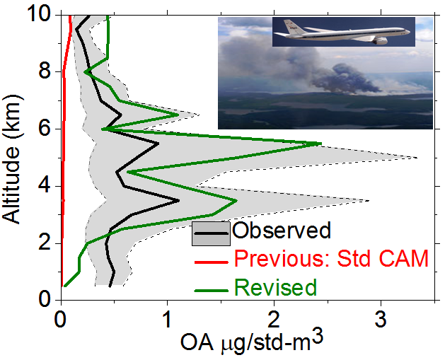
Advanced Secondary Organic Aerosol Paradigm in a Global Model Produces Large Improvements
Objective
Implement new parameterizations for SOAs in a global aerosol climate model based on newly developed knowledge of processes governing SOA formation and evolution
Approach
Evaluate the new advanced SOA parameterizations with surface, aircraft and satellite measurements
Demonstrate model performance compared to previous treatments
Revised SOA model (green) gives much better agreement with observed organic aerosol vertical profile measured downwind of biomass burning plumes over the Arctic region. Previous model (red) completely fails to simulate organic aerosol.
Impact
New SOA paradigms implemented for the first time in a global model produce large model improvement, especially in areas influenced by biomass burning emissions
Experimentally-based non-volatile SOA treatment increases predicted burdens and lifetimes of SOA globally
New treatment predicts about an order of magnitude higher direct radiative forcing by SOA compared to previous studies.
Shrivastava M, R Easter, X Liu, A Zelenyuk, B Singh, K Zhang K, P-L Ma, D Chand, S Ghan, JL Jimenez, Q Zhang, J Fast, P Rasch, and P Tiitta. 2015. “Global Transformation and Fate of SOA: Implications of Low Volatility SOA and Gas-Phase Fragmentation Reactions.” Journal of Geophysical Research-Atmospheres, accepted. DOI: 10.1002/2014JD022563
Notes:
http://www.pnnl.gov/science/highlights/highlights.asp?division=749

