Slide 1
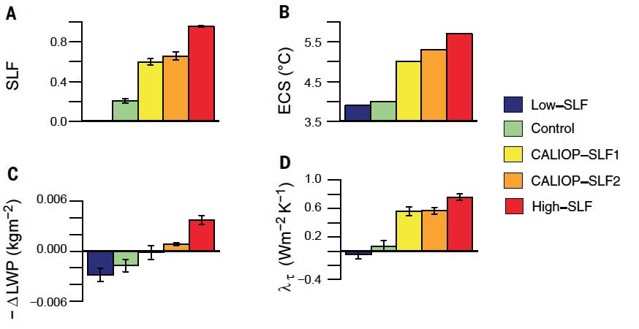
Observational constraints on mixed-phase clouds imply higher climate sensitivity
Objective: Given the known tendency for models to simulate clouds with too little liquid below freezing, the authors explored the implications of changing the supercooled liquid fraction (SLF) in a single model for its cloud feedback and climate sensitivity.
Research: The authors constrained cloud phase in CAM5.1 by using 79 months of observations obtained by CALIOP. To constrain CAM5.1-simulated SLFs to agree with observations, they adopted a quasi–Monte Carlo sampling approach to select 256 combinations of six cloud microphysical parameters, including the Wegener-Bergeron-Findeisen process time scale for the growth of ice crystals and the fraction of atmospheric aerosols active as ice nuclei. Simulations were run until the global net radiation budget at the top of the atmosphere was balanced with both present-day and doubled CO₂ concentrations.
(A) Initial-state extratropical SLFs at the –10°C isotherm. (B) Climate sensitivity estimates. (C) Changes in global mean liquid water path. (D) Mean extratropical cloud optical depth feedback.
Impact: The cloud phase feedback weakened and the climate sensitivity increased in model versions that maintain liquid down to colder temperatures. In the two model versions in which cloud phase was in closer agreement with observations, climate sensitivity was 1-1.3˚C larger than in the default model. Given that most climate models too readily convert liquid to ice below freezing, the results imply that they may also exaggerate the increase in cloud reflectivity with warming and hence underestimate climate sensitivity. Independent confirmation with other models will be important for establishing robustness.
Reference: Tan, I., T. Storelvmo, and M. D. Zelinka, 2016: Observational constraints on mixed-phase clouds imply higher climate sensitivity, Science, 352, 6282, 224-227, doi:10.1126/science.aad5300.
Notes:
A common feature of climate model simulations of global warming is an increase in the reflectivity of cold clouds at middle and high latitudes. This increase is primarily due to the increase in cloud liquid water content, part of which arises from phase transitions from ice to liquid. Because liquid clouds tend to be more reflective than ice clouds, this phase transition acts as a stabilizing feedback, limiting the amount of warming in response to increased carbon dioxide. The icier the clouds to begin with, the more liquid is gained as the planet warms, so this stabilizing feedback is stronger in models containing less liquid relative to ice at sub-freezing temperatures. Because most models’ clouds contain too much ice that is susceptible to becoming liquid with warming, their stabilizing cloud phase feedback may be unrealistically strong. To explore the implications of changing the ice-to-liquid ratio for cloud feedback and climate sensitivity, researchers at Yale and LLNL modified parameters in CESM version 1.0.6. They saw a systematic weakening of the cloud phase feedback and increase in climate sensitivity as they transitioned from model versions that readily convert liquid to ice below freezing to model versions that can maintain liquid down to colder temperatures. In the two model versions in which the ice-to-liquid ratio were in close agreement with clouds observed in nature by the CALIOP instrument, the model’s climate sensitivity was 1-1.3 degrees C larger than in the default model. Given that most climate models too readily convert liquid to ice below freezing, the results imply that they may also exaggerate the increase in cloud reflectivity as the atmosphere warms and hence underestimate climate sensitivity. Independent confirmation with other, less sensitive, models will be important for establishing the robustness of the result.

