Slide 1
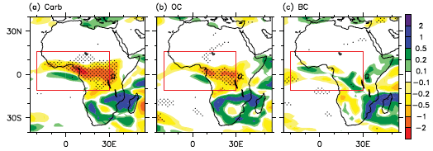
Carbonaceous Aerosols Could Suppress Regional Rainfall over Tropical Africa through Aerosol–Cloud Interactions
Objective
Explore potential impact of carbonaceous aerosols emitted from tropical Africa on regional rainfall and the process responsible for the change
Approach
Run climate simulations with Community Atmosphere Model version 5 (CAM5) with and without carbonaceous aerosol emissions over tropical Africa
Run sensitivity experiment with no aerosol cloud interaction in CAM5 by bypassing the aerosol radiation interaction calculation
Analyze regional rainfall difference and energy budget for these simulations to understand the potential impacts and responsible processes.
Rainfall changes resulting from emissions over tropical Africa of total (a), organic (b), and black (c) carbonaceous aerosol.
Impact
Aerosols are a known important climate forcing agent, and this research shows the potential role of carbonaceous aerosols emitted from biomass burning and other sources on African rainfall.
Yoon JH, PJ Rasch, H Wang, V Vinoj, and D. Ganguly. 2016. “The Role of Carbonaceous Aerosols on Short-term Variations of Precipitation over North Africa.” Atmospheric Science Letters, DOI: 10.1002/asl.672
Notes:
http://www.pnnl.gov/science/highlights/highlights.asp?division=749

