Slide 1
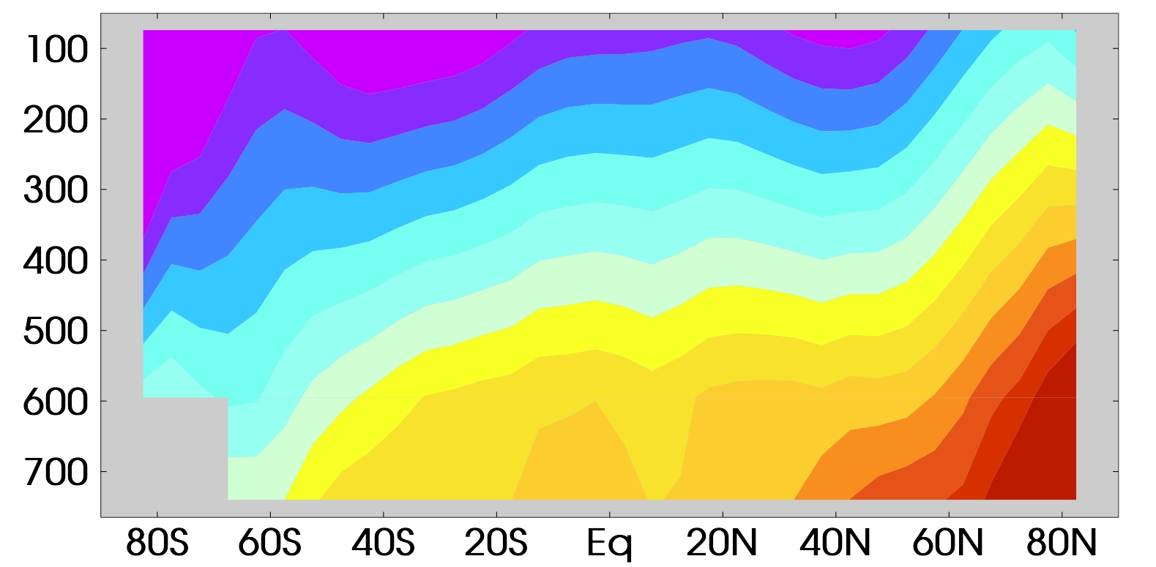
Human and Natural Influences on the Changing
Thermal Structure of the Atmosphere
Objective
To compare modeled and observed patterns of the vertical structure of atmospheric temperature change
Research
To determine whether anthropogenic “fingerprint” is statistically identifiable in satellite observations
To determine whether identification of a human-caused fingerprint is robust to current uncertainties in climate models and observations
Impact
A human-caused latitude/altitude pattern of atmospheric temperature change can be identified with high statistical confidence in satellite data – we show clear evidence of a discernible human influence on the thermal structure of the atmosphere
A human-caused fingerprint is identifiable not only relative to internal “climate noise”, but also relative to the larger total natural variability arising from changes in solar irradiance and volcanic forcing
Models: natural influences only
Models: human influences only
Satellite observations
Reference: B. D. Santer , J.F. Painter, C. Bonfils, C.A. Mears, S. Solomon, T.M.L. Wigley, P.J. Gleckler, G.A. Schmidt, C. Doutriaux, N.P. Gillett, K.E. Taylor, P.W. Thorne, and F.J. Wentz (2013): Human and natural influences on the changing thermal structure of the atmosphere. Proc. Natl. Acad. Sci., doi: 10.1073/pnas.1305332110.
-0.25
-0.15
-0.05
0.05
0.15
0.25
-0.3
-0.2
-0.1
0
0.1
0.2
0.3
Trend (°C/decade)
Atmospheric temperature trends in CMIP-5 models (top 2 panels) and in satellite observations from Remote Sensing Systems. For further details, refer to Fig. 2 in Santer et al. (2013)

