Slide 1
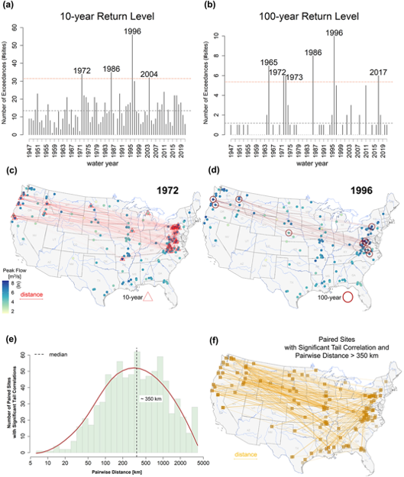
Compound continental risk of multiple extreme floods in the United States
Objective: To derive the first-of-its-kind continental portfolio risk estimates at the 10- and 100-year return levels using a non-parametric copula-based spatial simulations of peak floods across the United States.
Approach: We first demonstrate that patterns of multiple continental floods recur, posing a compound risk in the year of occurrence. We then utilize a non-parametric stochastic spatial simulator to model correlated floods across the continental United States and derive the first-of-its-kind aggregate flood exceedance or portfolio risk functions. The loss functions for aggregate continental flood hazard are estimated along with their uncertainty bounds for the 10- and 100-year flood return levels. We hypothesize that such compound effect could be a result of climate, and hence inferentially test the predictability of the losses using one or a set of potential atmospheric teleconnections.
Results/Impacts: We find significant interdependence in floods across the nation, revealing the recurring pattern of extreme events affecting the Northeast, Central, West, and Northwest United States in the same year. El Niño-Southern Oscillation and Atlantic Multidecadal Oscillation are identified as statistically significant tele-connectors of aggregate loss. The broader impact of this study is to establish a foundation that any country or region can use to evaluate potential consequences of compound risk from joint extreme events.
Najibi, N., Devineni, N., & Lall, U. (2023). Compound continental risk of multiple extreme floods in the United States. Geophysical Research Letters, 50, e2023GL105297. https://doi.org/10.1029/2023GL105297

