Slide 1
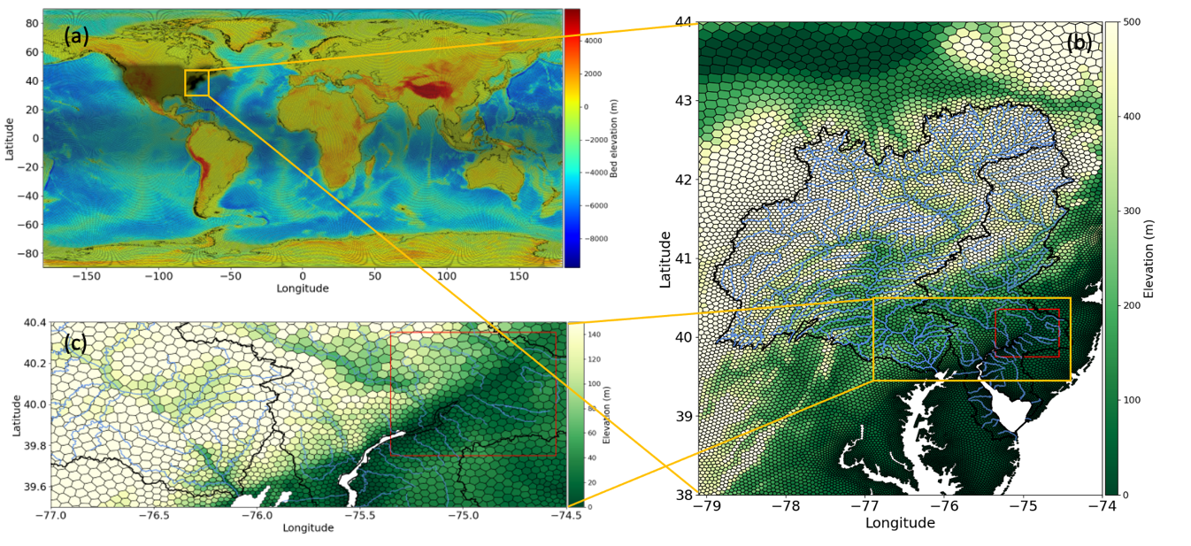
Investigating coastal backwater effects and flooding in the coastal zone using a global river transport model on an unstructured mesh
Objective
Simulate the coastal backwater effects over two mid-Atlantic watersheds using the river model under E3SM configured on a regionally refined unstructured mesh, with a focus to understand the backwater drivers and their long-term variation.
Approach
Develop a global unstructured mesh with the mid-Atlantic region refined
Prescribe the sea level variations at the downstream boundary of the river model
propose a new flood event selection scheme to facilitate the decomposition of backwater drivers into different components
Impact
Coastal backwater effects have crucial impacts on coastal flooding; With the regional refined unstructured mesh and the prescribed sea level boundary, the large-scale river model in E3SM has improved performance in capturing the backwaters.
The decomposition of backwater drivers in two mid-Atlantic watersheds show the crucial impacts from both storm surge and extreme river discharge.
The strength of backwater effects has increased over the past 40 years due to sea level rise and more frequent storm surge.
The global unstructured mesh with regions of interest refined allows the representation of coastal backwater effects in E3SM.
Feng, D., Tan, Z., Engwirda, D., Liao, C., Xu, D., Bisht, G., Zhou, T., Li, H.-Y., and Leung, L. R.: Investigating coastal backwater effects and flooding in the coastal zone using a global river transport model on an unstructured mesh, Hydrol. Earth Syst. Sci., 26, 5473–5491, https://doi.org/10.5194/hess-26-5473-2022, 2022.
Notes:
http://www.pnnl.gov/science/highlights/highlights.asp?division=749

