Slide 1
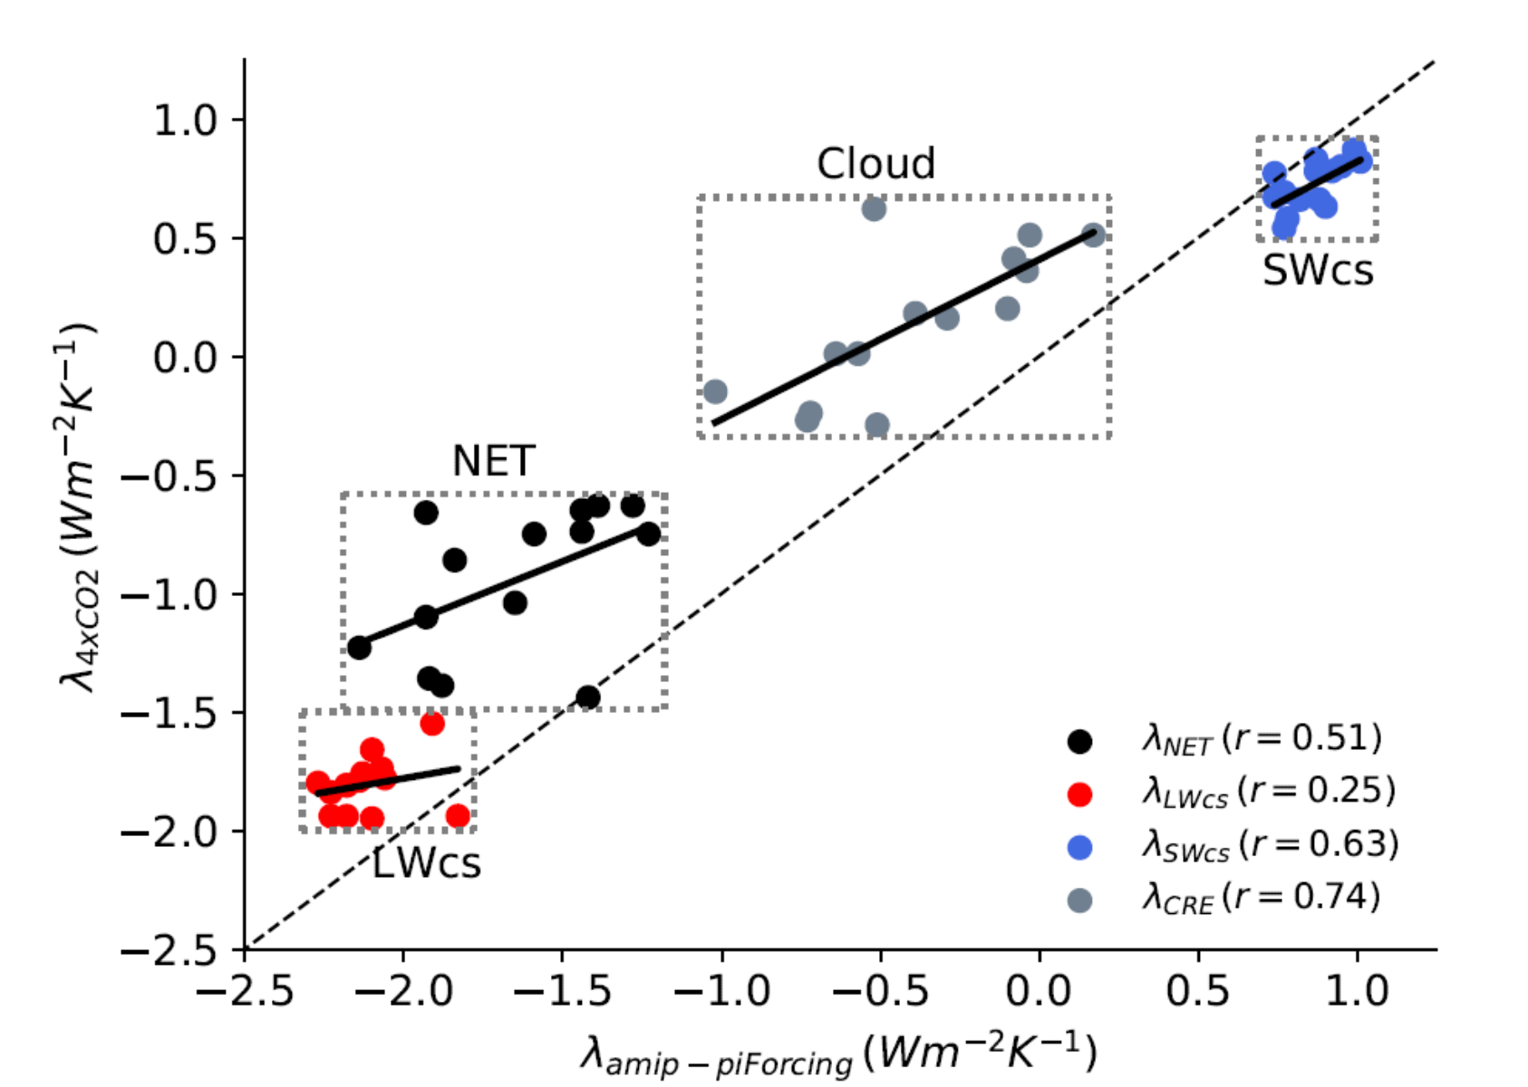
On the effect of historical SST patterns on radiative feedback
T.Andrews, A. Bodas-Salcedo, J. Gregory, Y. Dong, K. Armour, D. Paynter, P. Lin, A. Modak, T. Mauritsen, J. Cole, B. Medeiros, J. Benedict, H. Douville, R. Roehrig, T. Koshiro, H. Kawai, T. Ogura, J-L Dufresne, R. Allan, C. Liu Journal of Geophysical Research: Atmospheres, 2022, https://doi.org/10.1029/2022JD036675
Objective
Investigate how radiative feedbacks depend on the patten of sea-surface temperature warming.
Approach
Compare 14 “amip-piForcing” simulations from CMIP models forced by observed SST and sea-ice from 1870 to near present while keeping other forcing agents at pre-industrial levels
Quantify the radiative feedbacks and the “pattern effect”, splitting the time period into the early (1870-1980) and recent (1981-2010) intervals.
Repeat experiment with 9 models changing only the underlying SST dataset.
Compare feedbacks with long-term feedbacks from coupled abrupt 4xCO2 experiments with the same models
Impact
amip-piForcing radiative feedbacks capture most of the spread of the coupled abrupt 4xCO2 experiments
The pattern effect, i.e. the difference in the feedback parameter between the coupled 4xCO2 experiment and the amip-piForcing, is 0.70 ± 0.47 W m⁻² K⁻¹
The SST dataset has a small, but non-negligible, impact on the pattern effect
Radiative feedbacks differ between the early and recent periods, and the recent period is quite different from the abrupt4xCO2 feedbacks.
Since feedbacks since 1980 are differ from the longterm feedbacks, this well-observed period can not be used to constrain climate sensitivity.
Relationship across models (dots) between the feedback parameter in amip-piForcing (calculated over years 1871-2010) and abrupt-4xCO2 simulation (calculated over years 1-150). The net feedback parameter is decomposed into its longwave clear-sky, SW clear-sky and cloud radiative effect components. Deviations away from the one-to-one line indicate a difference in amip-piForcing and abrupt-4xCO2 λ (i.e. the pattern effect).

