Slide 1
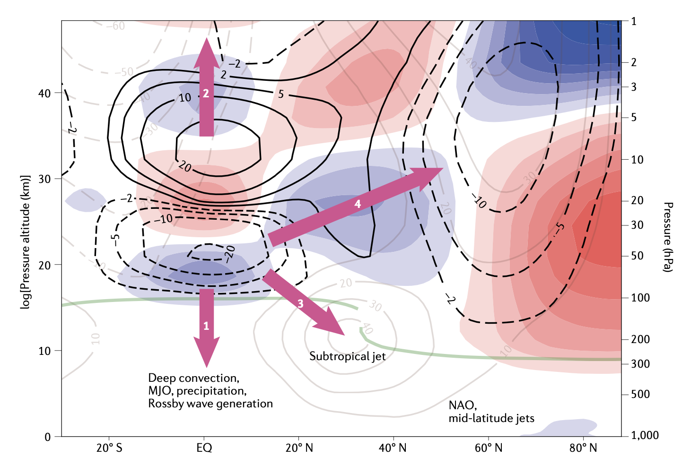
Impacts, processes and projections of the quasi-biennial oscillation (Review paper)
J. A. Anstey, … J. Richter (2022): Nature Reviews Earth & Environment https://doi.org/10.1038/s43017-022-00323-7
OBJECTIVE
To summarize the latest research related to impacts, processes and projections of the quasi-biennial oscillation (QBO)
Global QBO teleconnections and their pathways
APPROACH
Literature review of historical and recent advances on the QBO with a section on future perspectives
IMPACT
The QBO is the most prominent mode of variability in the lower tropical stratosphere. Many climate models are now able to simulate the QBO, but with systematic errors including weak amplitude in the lowermost stratosphere. The QBO affects predictability globally owing to its teleconnections to deep convection, MJO, precipitation, stratospheric polar vortex, mid-latitude jets and the North Atlantic Oscillation. The QBO has historically been very predictable, however since 2016 its regular cycling has been disrupted twice. There is large uncertainty in how the QBO will change in a warming climate, and why QBO teleconnections are underestimated in most global models.

