Slide 1
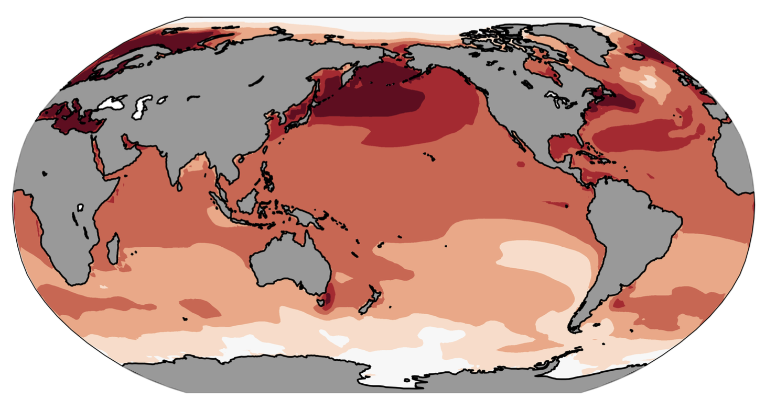
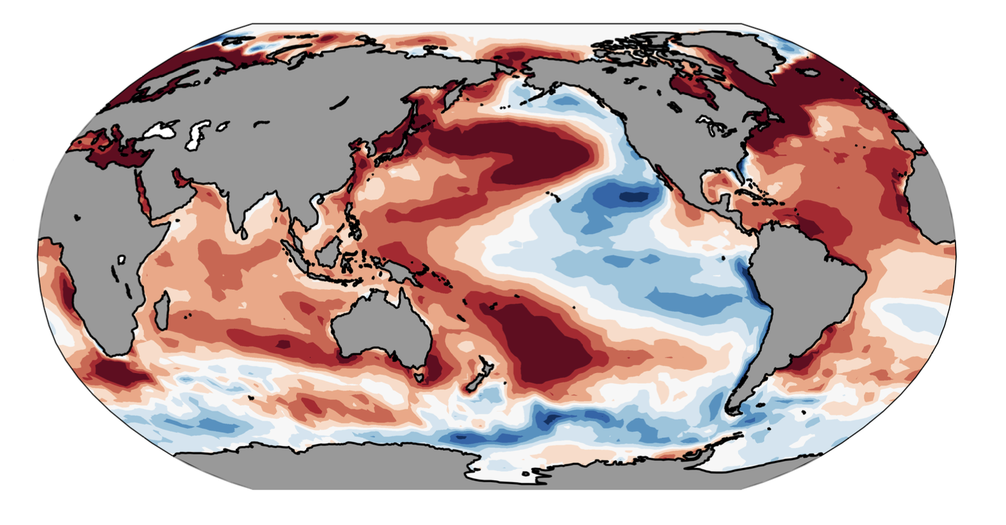
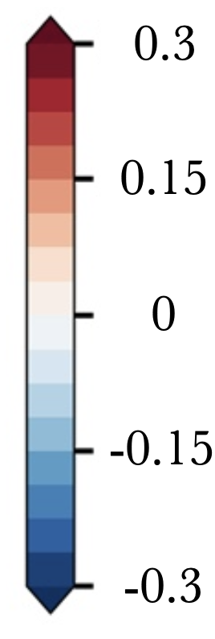
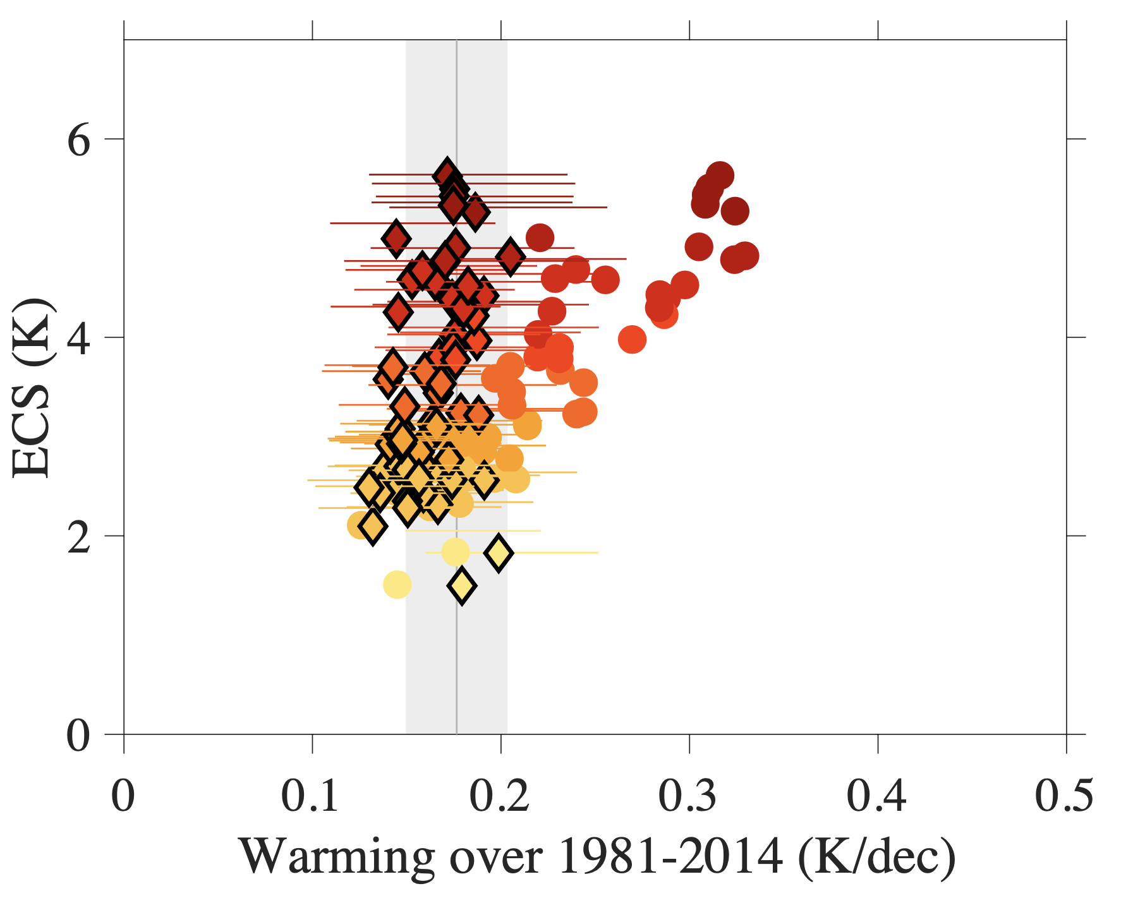
Sea-surface temperature pattern effects have slowed global warming and weakened constraints on the high end of climate sensitivity
Science Question:
The pattern of model-simulated warming since 1979 diverges from observations (top right).
How does this model bias affect global warming rates and estimates of climate sensitivity?
Approach:
Quantify the relationship between the pattern of warming, the effective climate feedback, and the rate of global mean temperature change using a hierarchy of models (energy balance, atmosphere-only, nudged coupled models, fully-coupled climate models).
Significance and Impacts:
The observed warming pattern has damped the historical rate of global temperature change.
Accounting for the pattern effect leads to high ECS models being consistent with the observed rate of warming (bottom right).
Observed warming provides a weak constraint on climate sensitivity.
CMIP5/6 Simulated Warming
Observed Warming
K/decade
C
Effect of Pattern Effect on ECS / Surface Warming Relationship (via energy balance models)
1979 - 2014
CMIP5/6 Models
CMIP5/6 Models Corrected for pattern bias
Observed
Warming Rate
Armour, K.C., C. Proistosescu, Y. Dong, L.C. Hahn, E. Blanchard-Wrigglesworth, A.G. Pauling, R.C.J. Wills, T. Andrews, M.F. Stuecker, S. Po-Chedley, I. Mitevski, P.M. Forster, J.M. Gregory: “Sea-surface temperature pattern effects have slowed global warming and biased warming-based constraints on climate sensitivity,” Proceedings of the National Academy of Science, accepted.

