Slide 1
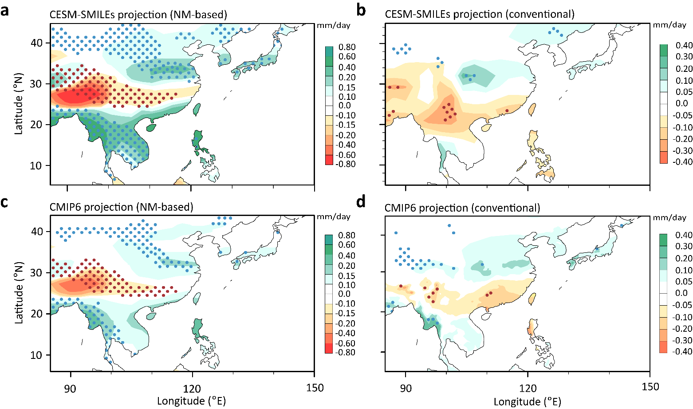
Fingerprinting the future pattern of the Asian Monsoon rainfall response
Objective
High uncertainty exists in future Asian monsoon summer rainfall projections from climate models.
The focus of this study is to show how to narrow this uncertainty is and understand the robust aspects of the Asian monsoon response to climate change.
Approach
Use the neutral modes (NMs), the most excitable precipitation patterns, as “fingerprints” to overcome the small signal-to-noise ratio problem inherent to the typical grid scale projection.
Take advantage of the Single-Model Initial-condition Large Ensemble simulations (SMILEs), which allows us to isolate the sources of uncertainties in the precipitation projection.
Impact
The NMs-based projection helps isolate the component of the climate change response with high signal-to-noise ratio and leads to much improved consensus across models.
The forced change in the leading NMs will emerge during the later half of the 21st century, while the trends in the variability of the NMs can be detected even earlier.
The NMs-based projection shows distinct patterns from the conventional multi-model ensemble mean, filtering out the unconfident component due to model uncertainty.
Comparison between the NM-based versus conventional precipitation projection of Asian summer monsoon rainfall. (a) NMs-based projection of the June – July – August precipitation by the end of the 21st century using the multi-ensemble mean of CESM-SMILEs; (b) Same as (a) but for the conventional grid-point projection ; (c) Similar to (a) but using the CMIP6 simulations projected onto the NM1 and NM2; (d) Same as (c) for the conventional grid-point projection.
Xue, D., J. Lu, L. R. Leung, H. Teng, F. Song, T. Zhou, Y. Zhang. “Robust projection of East Asian summer monsoon rainfall based on dynamical modes of variability.” Nature Communications, 4 (2023). [DOI: 10.1038/s41467-023-39460-y]

