Slide 1
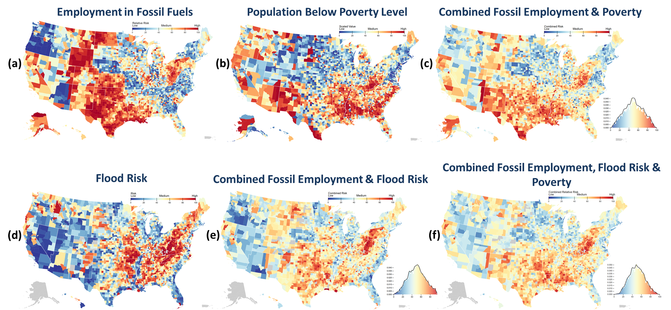
Assessing Compounding Risks
Objective: Provide a computationally efficient way to combine, analyze and visualize data reflecting a wide variety of socio-economic and environmental risks, and to identify regions where individual or combined risks are particularly high.
Findings: Platform assesses multiple, co-evolving, compounding risks and pinpoints risk “hotspots” within a U.S. geographical region from the national to the county level.
Impact: New “risk-triage” platform provides decision-makers with an efficient way to assess those risks that matter most to them and identify “hotspots” of compounding risks, which in turn can inform interventions to increase resilience.
Maps indicating transition and physical risks related to fossil fuels: (a) employment in fossil fuels (transition risk); (b) population below poverty level; (c) combined fossil employment and poverty (transition risk); (d) flood risk; (e) combined fossil employment and flood risk (physical risk); and (f) combined fossil employment, flood risk and poverty (both transition and physical risk).
Schlosser, C. A., C. Frankenfeld, S. Eastham, X. Gao, A. Gurgel, A. McCluskey, J. Morris, S. Orzach, K. Rouge, S. Paltsev and J. Reilly, Assessing Compounding Risks Across Multiple Systems and Sectors: A Socio-Environmental Systems Risk-Triage Approach, Frontiers in Climate, Vol 5 (2023) (doi: 10.3389/fclim.2023.1100600)

