Slide 1
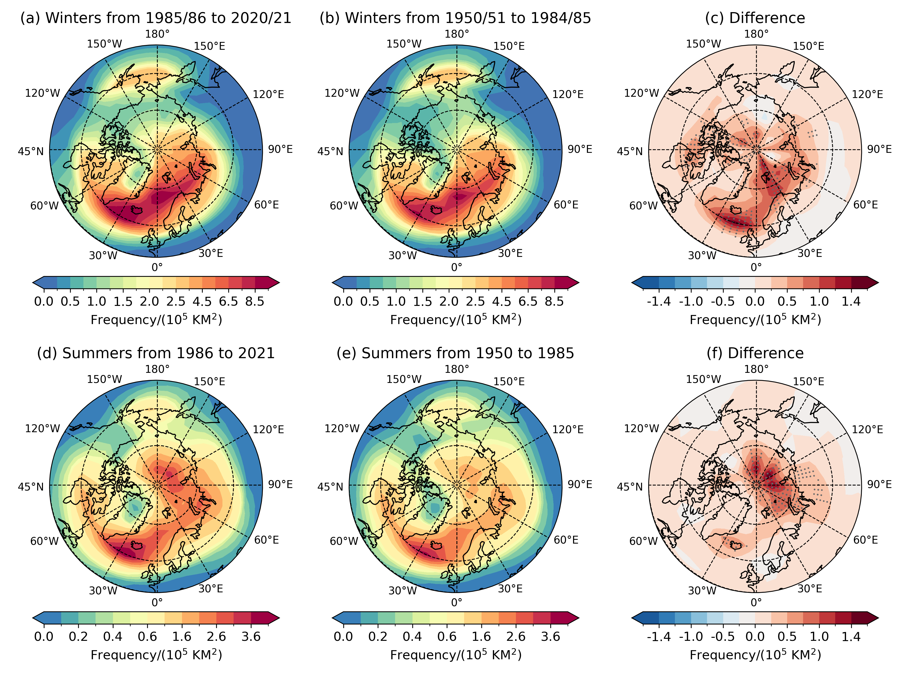
Arctic Cyclones Have Become More Intense and Longer-lived Over the Past Seven Decades
Scientific Challenge
Intense cyclones have been more frequently observed over the Arctic, causing extreme weather and climate events. However, it remains unclear how Arctic cyclones change along with the amplified warming and rapidly decreased sea ice in both observations and Earth System model simulations.
Approach and Findings
The study employs a newly improved cyclone identification and tracking algorithm, defines a new, energy-based cyclone activity metric, and utilizes multiple reanalysis datasets.
It is found that Arctic cyclone activity has intensified over the past seven decades, attributed to enhanced lower-troposphere baroclinicity, amplified winter jet streams, and strengthened summer lower-stratospheric Arctic vortex.
Figure
Significance and Impact
Cyclones are a fundamental dynamic driver for the poleward transient heat and moisture transport and surface turbulent heat, moisture, and momentum fluxes, contributing to and determining the Arctic energy and water cycles.
Cyclones are also a predominant driver for the occurrence of extreme weather and climate events, such as heat waves, heavy precipitation, strong winds, sea ice loss, ocean wave surges, and coastal flooding and erosion.
The findings provide benchmarks for evaluating and improving Earth System model simulations and projections of Arctic cyclones.
Frequency of occurrence of strong cyclones that propagate into or are generated locally within the Arctic region (north of 60ºN) for the winters from (a) 1985/86-2020/21 and (b) 1950/51-1984/85. (c) shows the differences between (a) and (b). (d)-(f) are the same as (a)-(c) but for the summers from 1986-2021 and 1950-1985. The dots in (d) and (f) indicate that the differences are statistically significant at the level of p < 0.10 using the two-sided t-test.
Zhang, X., Tang, H., Zhang, J. Walsh, J. E., Roesler, E. L., Hillman, B., Ballinger, T. J., & Weijer, Arctic cyclones have become more intense and longer-lived over the past seven decades. Communications Earth & Environment, 4, 348 (2023). https://doi.org/10.1038/s43247-023-01003-0
Department of Energy • Office of Science • Biological and Environmental Research
Notes:
Word highlight text here.

