Slide 1
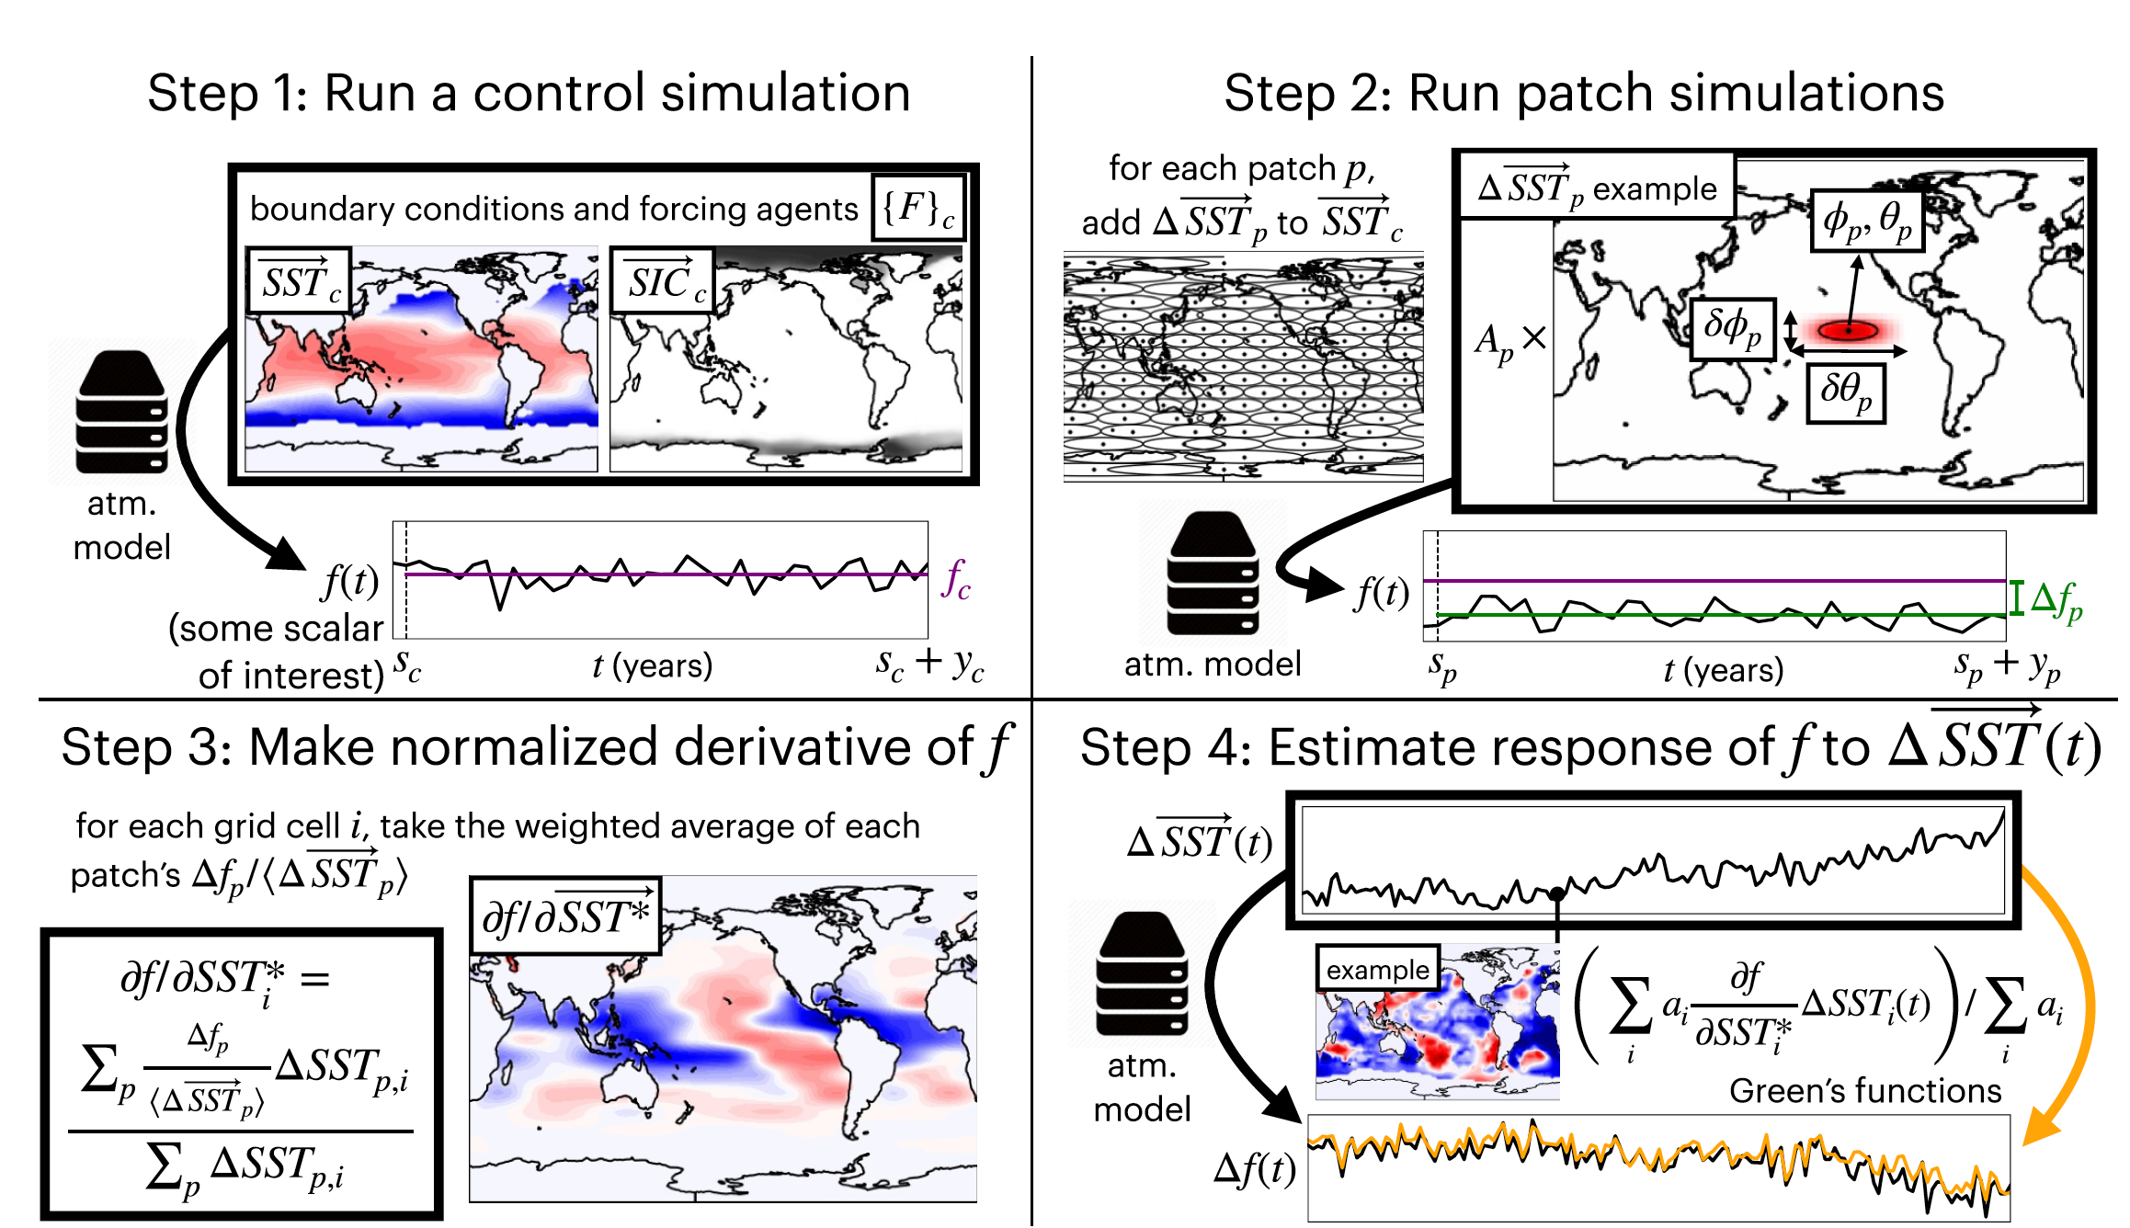
The Green’s Function Model Intercomparison Project (GFMIP) Protocol
Science Question:
Uncertainty in climate sensitivity is primarily controlled by how top-of-atmosphere radiative fluxes respond to surface warming.
How do these top-of-atmosphere radiative fluxes depend on warming in different regions (i.e. what is the strength of the so-called “pattern effect”)?
Approach:
The dependence of top-of-atmosphere radiative fluxes on patterns of warming in different regions is quantified using a Green’s Function approach: we simulate the radiative response to a delta function-like patch of warming is imposed in a single location. We then repeat the experiment for a set of patches that cover the entire surface of the Earth.
Significance and Impacts:
Uncertainty in the pattern effect is a primary reason for why past warming cannot constrain future warming.
In this work we provide a standard, optimal, protocol for quantifying the pattern effect via Green’s Functions
A schematic illustrating the Green's function method for modeling the dependence of an atmospheric variable, f, on the sea surface temperature field, SST.
Bloch‐Johnson, J., Rugenstein, M. A., Alessi, M. J., Proistosescu, C., Zhao, M., Zhang, B., ... & Zhou, C. (2024). The green's function model intercomparison project (GFMIP) protocol. Journal of Advances in Modeling Earth Systems, 16(2), e2023MS003700.

