Slide 1
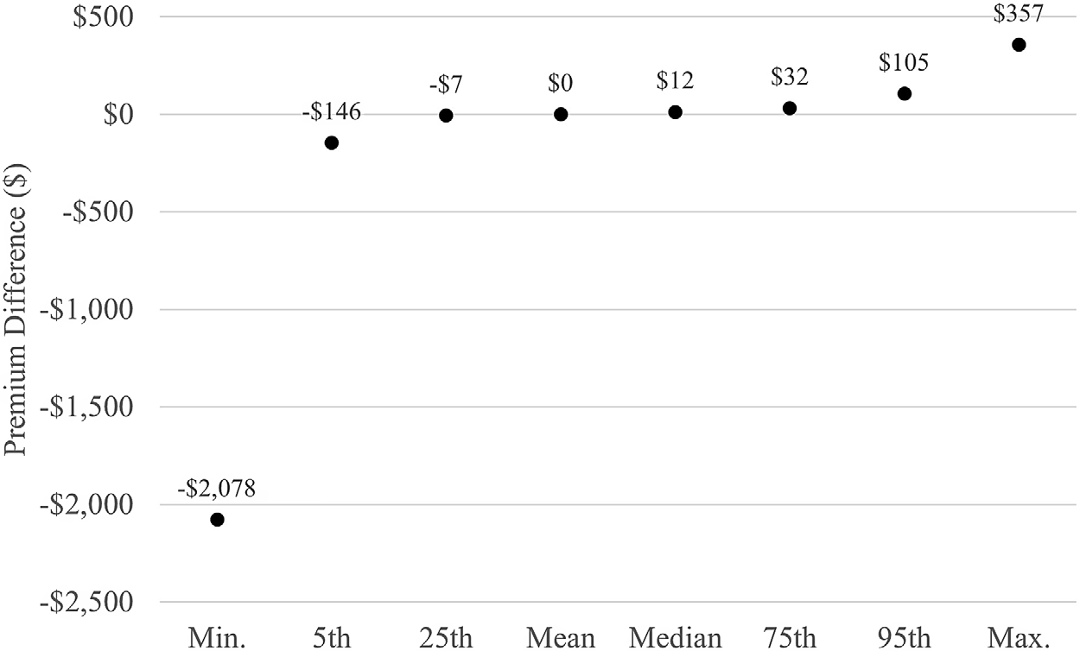
The distributional impact of FEMA’s community rating system
Objective
Between 1988 and 2017, losses from floods—a significant portion of all natural disasters worldwide—amounted to $200 billion in the US. By offering premium savings for implementing floodplain management measures, FEMA’s CRS program encourages municipalities to enroll in the federally managed National Flood Insurance Program (NFIP). But equity and sustainability concerns arise as discounts for CRS communities are balanced by premium hikes in non-CRS areas.
Approach
We use FEMA’s data on actual paid premiums, the CRS status of all NFIP communities, and the information on premium cross-subsidization to calculate counterfactual premiums for each household in a world without CRS. The influence of CRS on premium payments across the NFIP program is examined by comparing real and counterfactual premiums.
Statistics for distribution of premium differences. Note: The figure shows statistics describing the distribution of PremDiff outcome variable in our CRS model. The premium differences are produced by subtracting counterfactual premiums, i.e., those produced after removing CRS discounts, from the CRS-adjusted premiums that show up in the raw FEMA data. The values take on positive and negative values because, after removing CRS subsidies, some households would see their premiums increase and others see them decrease.
Impact
Subsidy redistribution has little economic impact, with 95% of households earning or losing less than 0.3% of income. Flood risk level is the greatest predictor of premium decreases, suggesting that CRS lowers living costs in riskier locations.
Brent D. A., Ren Y., Wrenn D. (2024). The distributional impact of FEMA’s community rating system. Agricultural and Resource Economics Review, pp. 1 – 32. https://doi.org/10.1017/age.2023.37

