Slide 1
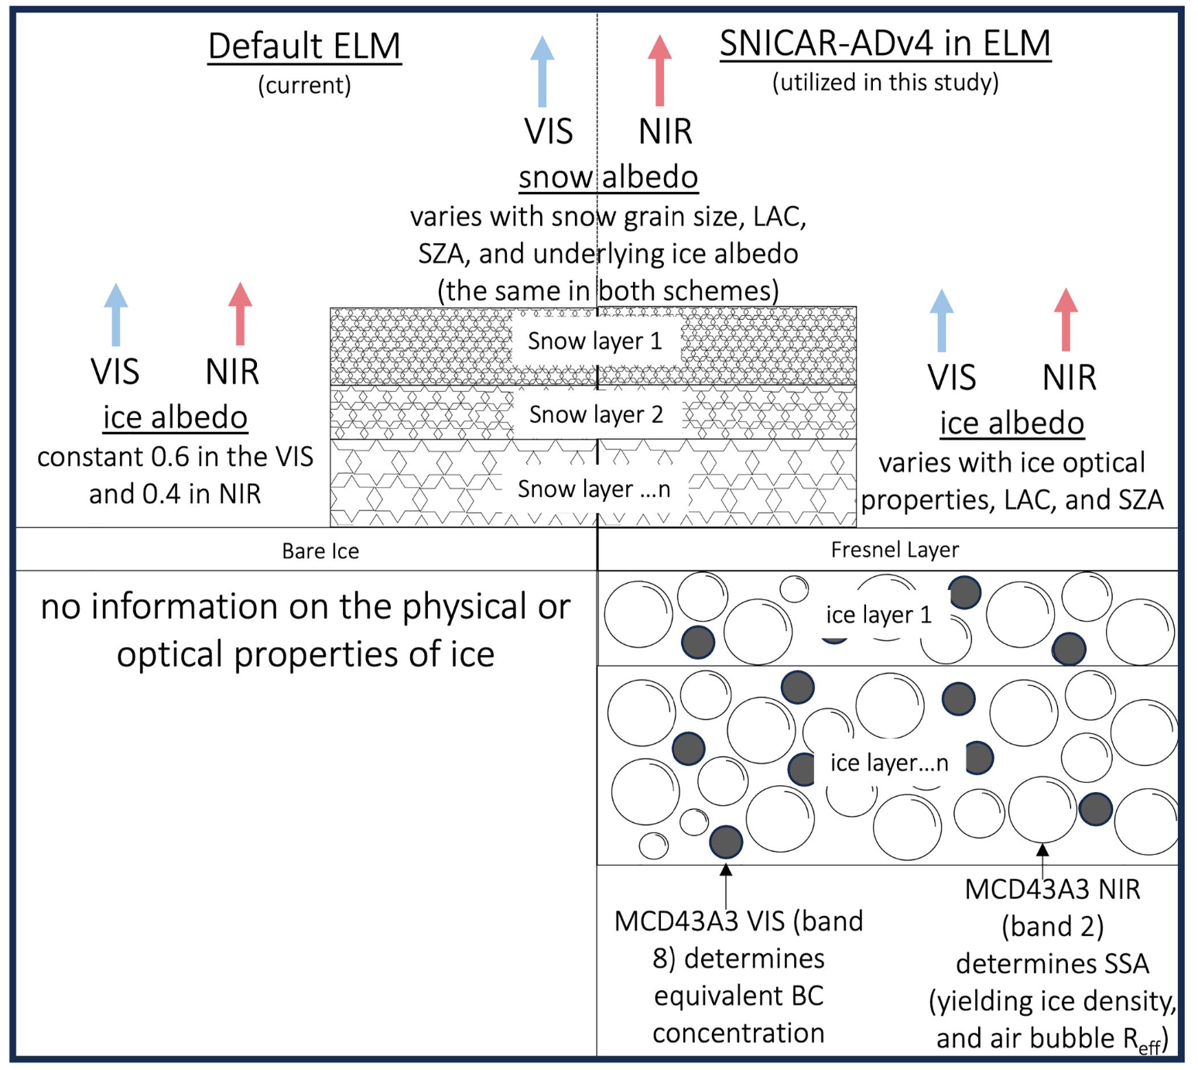

The Effect of Physically Based Ice Radiative Processes on
Greenland Ice Sheet Albedo and Surface Mass Balance in E3SM
Objective
Improve bare ice albedo and radiative transfer processes in E3SM
Quantify v2 surface energy bias due to spatio-temporally constant bare ice albedo
Quantify impact of physically realistic bare ice albedo on surface mass balance
Approach
Improve E3SMv2 Land Model snow radiation model to work for bare ice (SNICAR-ADv4)
Infer bare ice physical properties from MODIS observations, use in 2000-2021 simulations
Compare simulations with realistic bare ice albedo to default ELM constant bare ice albedo
Findings & Impact
Ice albedo in the Greenland Ice Sheet ablation zone is ~5% less than previously thought
Realistic ice albedo increases surface melt by ∼6 Gt/year from 2000 to 2021
SNICAR-ADv4 allows for more realistic ice surface melt and surface energy budget
More realistic estimates of sea-level rise and surface heating
Figure 1: Schematics of ELM default (left) and new SNICAR‐ADv4 (right) land ice radiative treatments.
Figure 2 (right): MODIS albedo compared to the default ELM scheme and the SNICAR-ADv4 scheme. From left to right, MODIS albedo, default ELM albedo, SNICAR-ADv4 enabled ELM albedo, the difference between the ELM default and MODIS albedo, the difference between SNICAR-ADv4 enabled ELM and MODIS albedo.
Citation: Whicker-Clarke, C. A., R. Antwerpen, M. G. Flanner, A. Schneider, M. Tedesco, and C. S. Zender (2024), The Effect of Physically Based Ice Radiative Processes on Greenland Ice Sheet Albedo and Surface Mass Balance in E3SM Journal of Geophysical Research: Atmospheres, 129, e2023JD040241. https://doi.org/10.1029/2023JD040241
Department of Energy • Office of Science • Biological and Environmental Research

