Slide 1
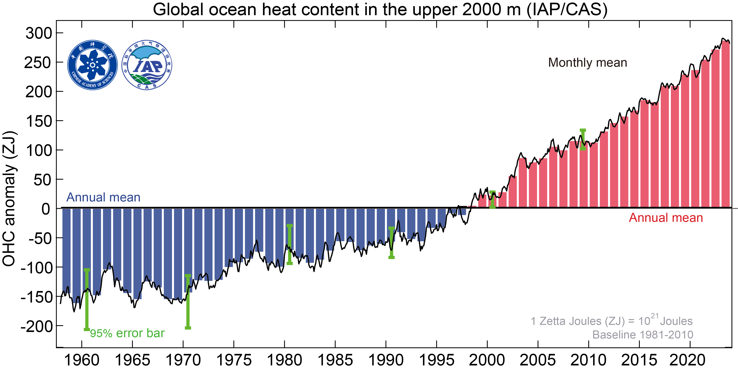
New Record Ocean Temperatures and Related Climate Indicators in 2023
Cheng, L., Abraham, J., Trenberth, K.E., Boyer, T., Mann, M. E., Zhu, J., Wang, F., Yu, F., Locarnini, R., Fasullo, J.T., et al. New Record Ocean Temperatures and Related Climate Indicators in 2023. Adv. Atmos. Sci. (2024). https://doi.org/10.1007/s00376-024-3378-5.
OBJECTIVE
Over 90% of the Earth’s energy imbalance under climate change is absorbed by the ocean, making ocean heat content a critical index for tracking climate change. This work uses two data products to estimate key indicators of the ocean state in 2023, including an analysis of various salinity-based indices to track changes in stratification and water cycle intensity.
APPROACH
Sampling of ocean temperatures remains sparse, requiring various methods for infilling data gaps and correcting for biases in observations. In this work, two state-of-the-art methods for performing this infilling are used to estimate changes from the mid 20th Century.
IMPACT
This work tracks the progression of global warming in fields that exhibit a high signal to noise ratio as compared to surface temperature. The findings reveal continued increases in Earth’s ocean heat uptake, upper ocean stratification, and salinity spatial contrasts, underscoring the ongoing effects of climate change on Earth’s energy and water cycles.
Global upper 2000 m OHC from 1958 through 2023 including annual means (bars) and monthly values (black line). Uncertainty ranges for yearly estimates are also shown (green).

