Slide 1
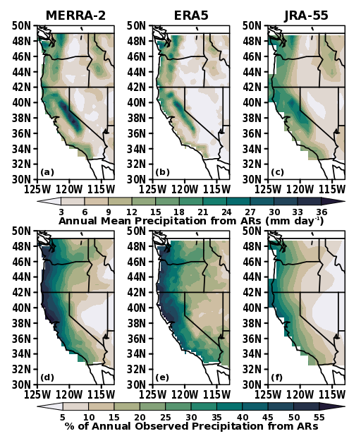
An Overview of ARTMIP’s Tier 2 Reanalysis Intercomparison: Uncertainty in the Detection of Atmospheric Rivers and their Associated Precipitation
Collow, A.B., Shields, C.A., Guan, B., Kim, S., Lora, J.M., McClenny, E.E., Nardi, K., Payne, A., Reid, K., Shearer, E. J. , Tome, R., Wille, J.D., Ramos, A.M., Gorodetskaya, I.V., Leung, L.R., O’Brien, T.A., Ralph, F.M., Rutz, J. Ullirich, P.A., Wehner, M.
Journal of Geophysical Research - Atmospheres: https://doi.org/10.1029/2021JD036155
OBJECTIVE
Understand and quantify uncertainties in AR metrics such as precipitation due to AR detection tools (ARDTs) across different reanalysis products.
APPROACH
Atmospheric River Tracking Method Intercomparison Project, Tier 2 Reanalysis Intercomparison framework, 11 ARDTs and 3 reanalysis products.
IMPACT
Differences due to ARDTs are larger than differences due to reanalysis. Enhanced integrated water vapor transport in MERRA-2 leads to increased detection of ARs with fixed thresholds. ARDTS with relative thresholds have better agreement between reanalyses than absolute thresholds.
Annual mean intensity of precipitation associated with consensus ARs in MERRA-2, ERA5, and JRA-55 (top). AR cumulative precipitation as a percentage of the total annual precipitation (bottom).

