Slide 1
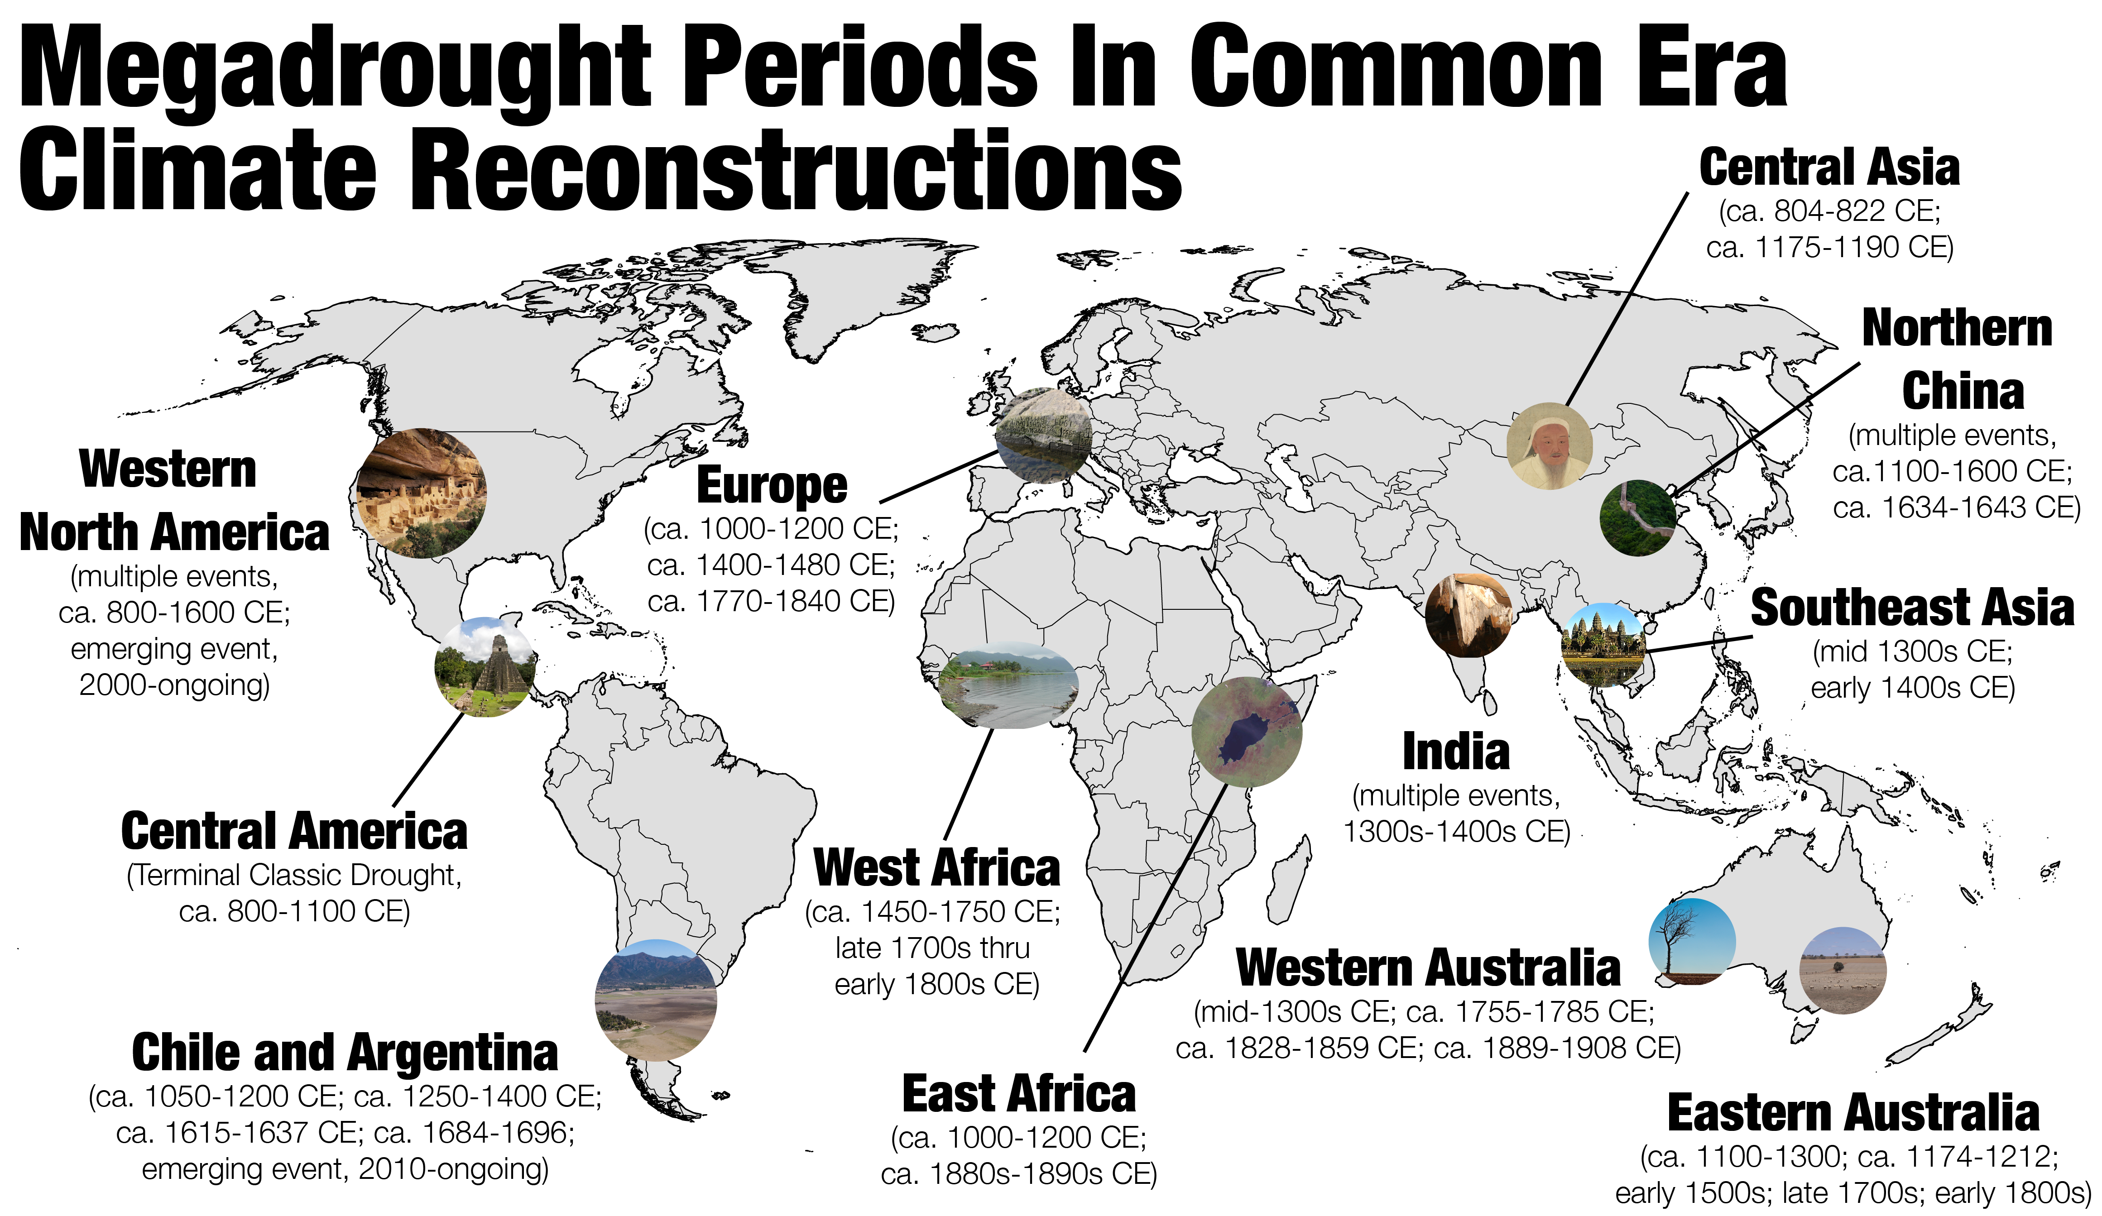
Megadroughts in the Common Era and the Anthropocene
Cook, B. I., Smerdon, J. E., Cook, E. R., et al., 2022, Nature Reviews Earth and Environment, 3, 741-757.
Objective
Exceptional drought events, known as megadroughts, have caused major ecological and societal disturbances in the past. While most megadrought research has focused on North America, the concept has gained increased international attention in recent years. However, several knowledge gaps currently undermine confidence in our understanding of past and future megadroughts, which we address detail.
Approach
We discuss shared causes and features of Common-Era and future megadroughts. Paleoclimate reconstructions spanning the Common Era document the occurrence of megadroughts on every continent, save Antarctica. Anthropogenic climate change has already contributed to recent megadroughts and will likely increase future megadrought risk and severity in many regions. Future megadroughts will be differentiated from past events through higher temperatures, which act as the main driver of increased risk and severity in climate projections.
Figure. Megadroughts have occurred on every continent outside of Antarctica during the Common Era. In some regions, these were isolated events (Central Asia), while other regions experienced extended, centennial-scale periods of recurrent megadrought activity (Western North America, Chile and Argentina). Megadroughts had documented impacts on human societies in Western North America, Central America, and Northern China. Megadroughts are an intrinsic part of natural hydroclimate variability during the Common Era, affecting regions on every continent outside of Antarctica, with often large effects on ecosystems and societies.
Impact
We provide an assessment of important challenges that must be addressed to move megadrought research forward, including the paucity of high-resolution paleoclimate information over some regions, incomplete representations of internal variability and land-surface processes in climate models, and the undetermined capacity of water-resource management systems to manage megadrought impacts. Resolving these will be necessary to increase confidence in projections of future megadrought risk.

