Slide 1
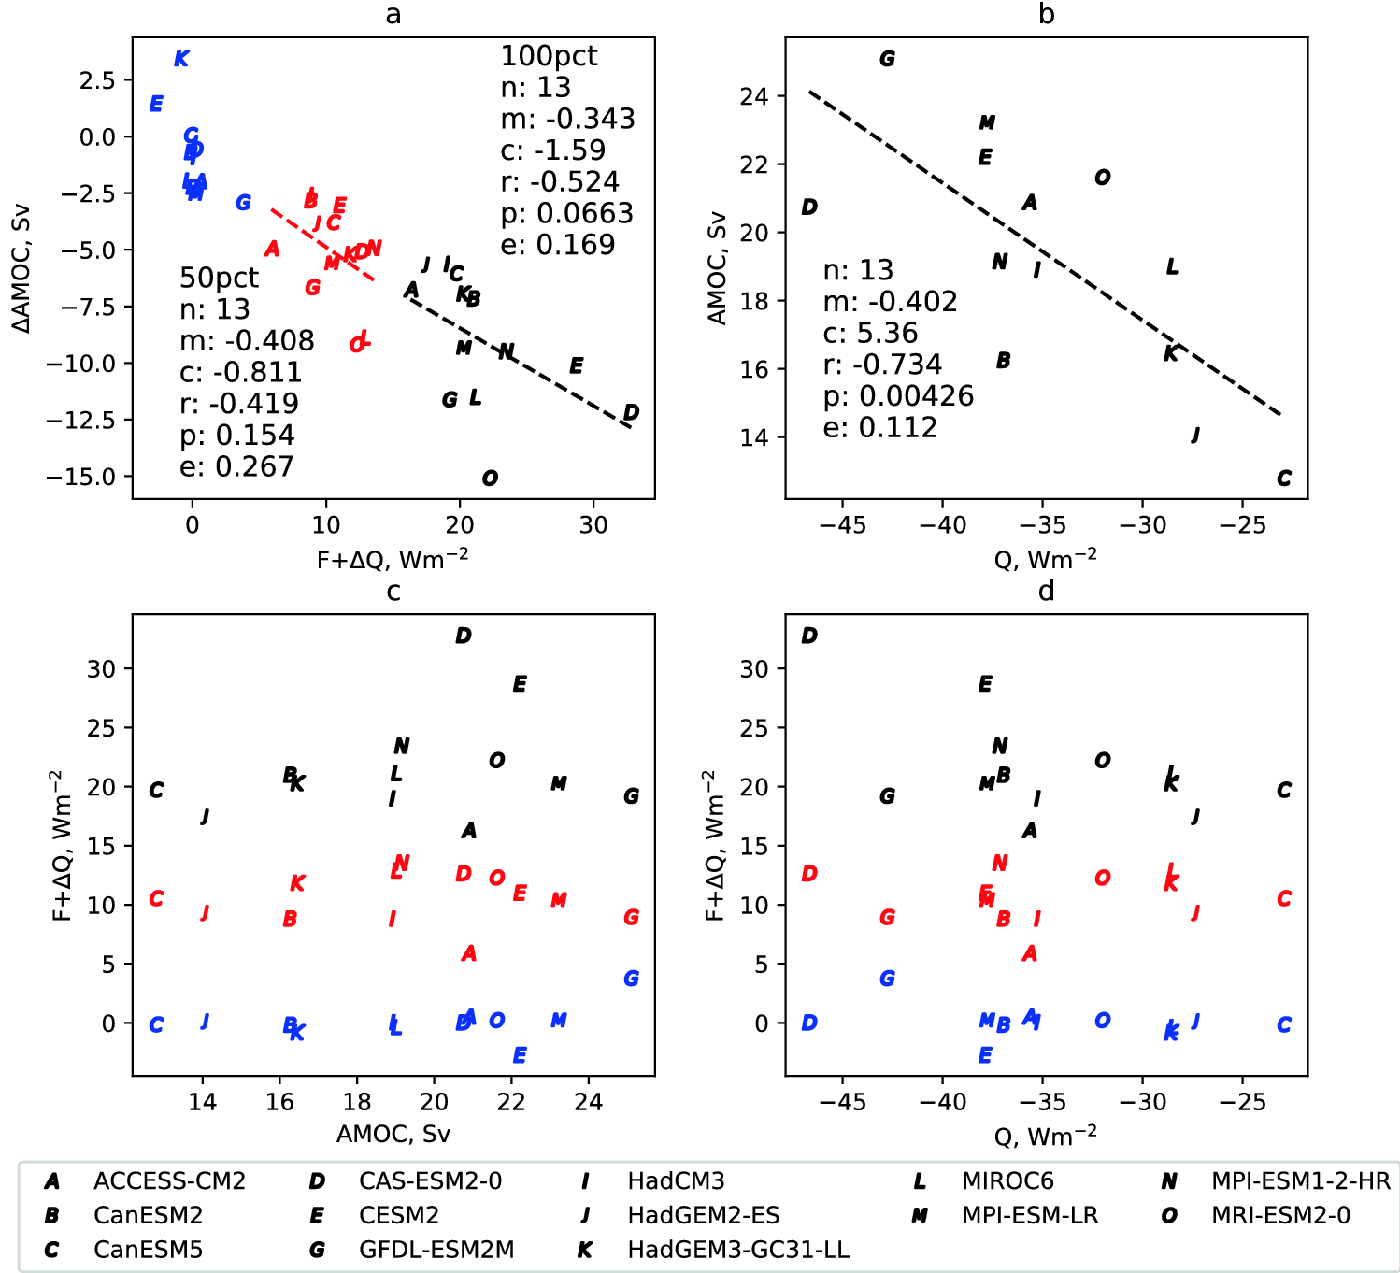
Greenhouse-gas forced changes in the Atlantic meridional overturning circulation and related worldwide sea-level change
Objective: The effect of anthropogenic climate change in the ocean is challenging to project because atmosphere-ocean general circulation models (AOGCMs) respond differently to forcing. This study focuses on changes in the Atlantic Meridional Overturning Circulation (AMOC), ocean heat content , and the spatial pattern of ocean dynamic sea level. We analyze experiments following the FAFMIP protocol, in which AOGCMs are forced at the ocean surface with standardized heat, freshwater and momentum flux perturbations, typical of those produced by doubling CO₂.
Approach: Analyzing the FAFMIP simulations from multiple CMIP6 class models.
Results/Impacts: Using two new heat-flux-forced experiments, we find that the AMOC weakening is mainly caused by and linearly related to the North Atlantic heat flux perturbation, and further weakened by a positive coupled heat flux feedback. The quantitative relationships are model-dependent, but few models show significant AMOC change due to freshwater or momentum forcing, or to heat flux forcing outside the North Atlantic. AMOC decline causes warming at the South Atlantic-Southern Ocean interface. It does not strongly affect the global-mean vertical distribution of ocean heat content, which is dominated by the Southern Ocean. AMOC decline strongly affects ocean dynamic sea level in the North Atlantic, with smaller effects in the Southern Ocean and North Pacific. The ensemble-mean ocean heat content and dynamic sea level patterns are mostly attributable to the heat added by the flux perturbation, with smaller effects from ocean heat and salinity redistribution. The ensemble spread, on the other hand, is largely due to redistribution, with pronounced disagreement among the AOGCMs.
Figure 1. Relationships between total heat input into NA box and AMOC change for 100pct (black), 50pct (red) and 0pct (blue) for 13 models. a Descriptive statistics are shown for 100pct and 50pct but the relationships are not significant (p > 0.05) . Control heat flux averaged over the NA box versus control AMOC strength, with descriptive statistics, (b). Control AMOC strength versus total heat input into NA box for the three experiments, where no significant relationship exists, (c). Control heat flux averaged over the NA box versus total heat input into NA box for the three experiments, where no significant relationship exists, (d)
Couldrey, M. P., J. M. Gregory, X. Dong, O. Garuba, H. Haak, A. Hu, W. J. Hurlin, J. Jin, J. Jungclaus, A. Kohl, H. Liu, S. Ojha, O. A. Saenko, A. Savita, T. Suzuki, Z. Yu & L. Zanna, 2023, Greenhouse-gas forced changes in the Atlantic meridional overturning circulation and related worldwide sea-level change, Climate Dynamics, published online Aug. 2, 2022.

