Slide 1
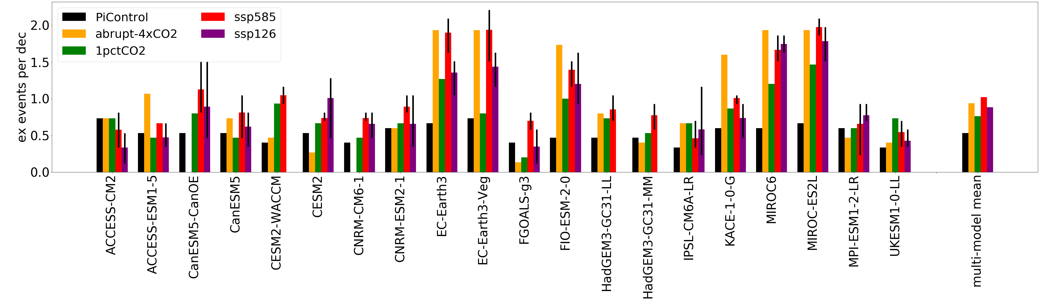
Towards understanding the robust strengthening of ENSO and more frequent extreme El Niño events in CMIP6 global warming simulations
Scientific Challenge
ENSO has profound impacts on weather patterns across the globe, yet there is no consensus on its response to global warming. Climate models have been used to make projections of ENSO changes for several decades now, but debates on the future of ENSO continue.
(a) ENSO SST amplitude
Approach and Findings
Using data from CMIP6 and four types of warming experiments, we show that most models predict a stronger ENSO by century-end in Shared Social Pathway (SSP) experiments, and in idealized 1pctCO2 and abrupt 4xCO2 experiments. The frequency of extreme El Niño events and precipitation variability increase as well. Some of these changes in ENSO sea surface are correlated with the projected future reduction in the mean zonal SST gradient. A stronger atmospheric noise, including westerly wind bursts, is another factor.
(b) Frequency of extreme El Nino events
Significance and Impact
We have demonstrated that the most recent climate model intercomparison (CMIP6) indicates a robust strengthening of ENSO with global warming, accompanied by a pronounced increase in the frequency of extreme El Niño events.
Overview of ENSO changes in CMIP6 models across different experiments. (a) A barplot showing the time-mean amplitude of ENSO SST variability in individual models for the piControl, abrupt-4xCO2, 1pctCO2, SSP585 and SSP126 experiments, respectively. Thin errorbars for SSP experiments indicate the maximum and minimum values across three ensemble members. (b) The same but for the frequency of extreme El Niño events. Arrows indicate the direction of changes in the multi-model mean ensemble.
Heede, U.K., Fedorov, A.V. Towards understanding the robust strengthening of ENSO and more frequent extreme El Niño events in CMIP6 global warming simulations. Clim Dyn 61, 3047–3060 (2023).
Department of Energy • Office of Science • Biological and Environmental Research
Notes:
SCIENCE
The El Niño Southern Oscillation (ENSO) has profound impacts on weather patterns across the globe, yet there is no consensus on its response to global warming. State-of-the-art climate models have been used to make projections of ENSO changes for several decades now, but vigorous debates on the future of ENSO still continue.
IMPACT
This study shows that the most recent model intercomparison (CMIP6) indicates a robust strengthening of ENSO with global warming, accompanied by a pronounced increase in the frequency of extreme El Niño events. Thee potential mechanisms of these changes are analyzed.
SUMMARY
Using a broad range of models from the Coupled Model Intercomparison Project phase 6 (CMIP6) and four types of warming experiments, here we show that the majority of the models predict a stronger ENSO by century-end in Shared Social Pathway (SSP) experiments, and in idealized 1pctCO2 and abrupt 4xCO2 experiments. The frequency of extreme El Niño events and precipitation variability increase as well. Some of these changes in ENSO sea surface are correlated with the projected future reduction in the mean zonal SST gradient. A stronger atmospheric noise, including westerly wind bursts, is another factor. Nevertheless, we argue that a robust inter-model mechanism that could consistently explain a stronger ENSO simulated with global warming is still lacking. Therefore, caution should be exercised when considering ENSO changes based on a single model or warming scenario.

