Slide 1
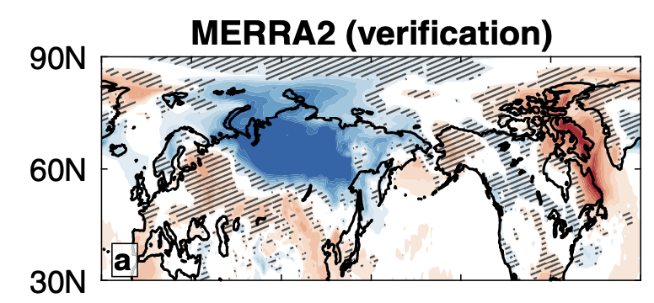
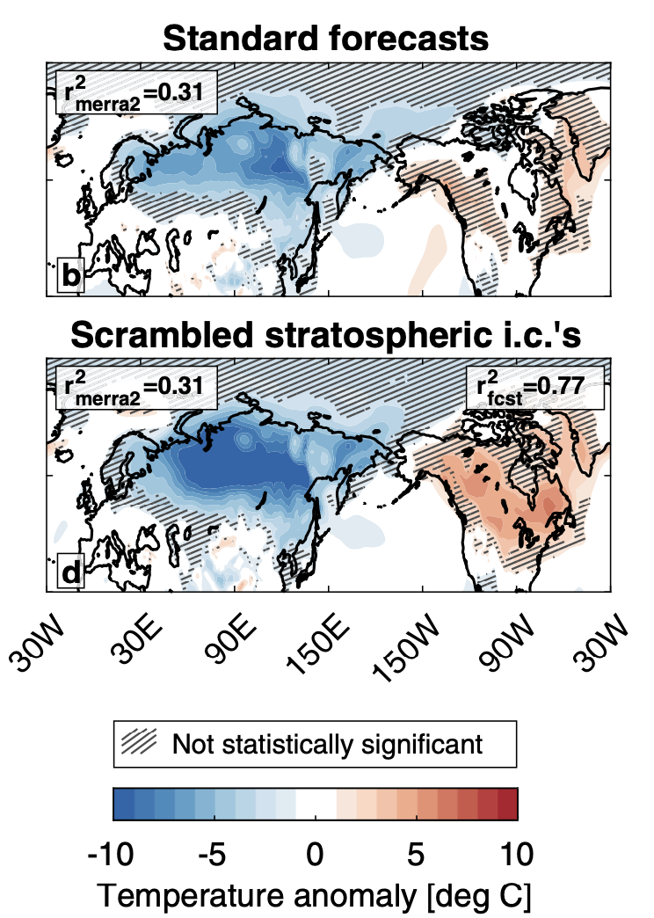
Limited surface impacts of the January sudden stratospheric warming
N. A. Davis, J. H. Richter, A. A. Glanville, J. Edwards & E. LaJoie (2022): Nature Communications, https://doi.org/10.1038/s41467-022-28836-1
OBJECTIVE
To assess the drivers of surface weather following the Jan 5, 2021 sudden stratospheric warming (SSW)
APPROACH
We use the CESM2(WACCM6) subseasonal prediction system and carry out experiments with “scrambling” different parts of atmospheric initial conditions
Average surface temperature anomalies 3 and 4 weeks after the Jan 2021 SSW.
IMPACT
SSWs are typically followed by cold and stormy weather throughout Europe and United States, and warm temperatures in Northern Canada. Such a pattern was observed following the Jan 5th 2021 SSW. By performing unique experiments with the CESM2(WACCM6) subseasonal system we showed that the SSW itself had a limited impact on surface weather, and we do not find evidence that the event itself, nor the polar vortex stretching and wave reflection, caused or otherwise influenced the record cold in North America in February 2021. Instead, the tropospheric circulation and bidirectional coupling between the troposphere and stratosphere were dominant contributors.

