Slide 1
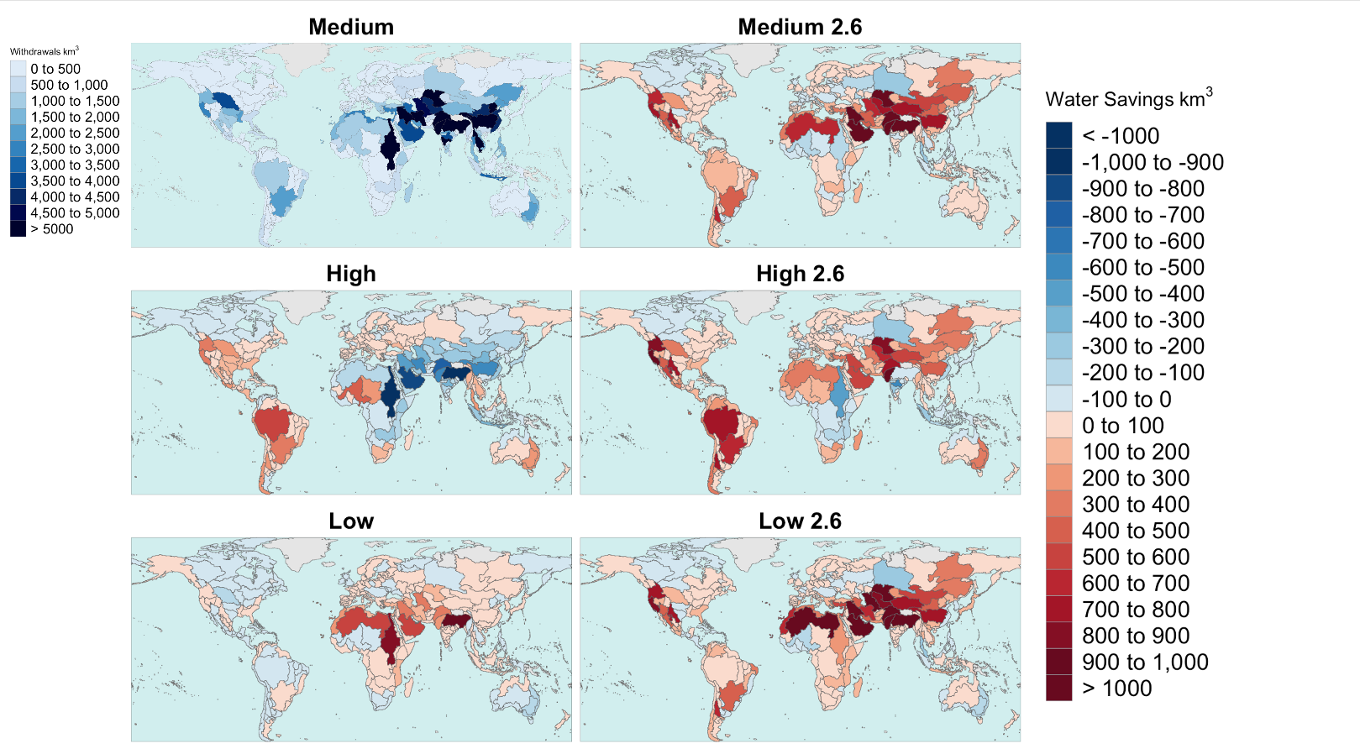
Investigating Agricultural Trade’s Impact on Global Water Resources
Objective
Understand the implications of global agricultural trade on the future demand for regional and global water resources.
Approach
Use the Global Change Analysis Model (GCAM) to explore future scenarios of agricultural trade variability.
Quantify the total water required to meet global agricultural demands under business-as-usual development through 2100.
Evaluate the impact of alternative inter-regional agricultural trade and carbon transition scenarios on the demand for regional water resources.
Impact
The results show virtual water exports of renewable water change by +400% and -20% when agricultural trade increased or decreased globally.
From our study, changing the level of global agricultural trade in the future cause local water resources to undergo significant demand shifts. 65% of the total water demand changes are sourced from nonrenewable groundwater extraction in dry regions.
This work presents one of the first analyses of water-related impacts from changing global agricultural trade, laying a foundation for future regional and global studies.
Depending on the degree of future trade, global agricultural water demands may vary by up to 6,000 km³, or the volume of Lake Michigan, from 2020-2100 as production shifts to different regions around the world.
Graham N. T., G. C. Iyer, T. Wild, F. C. Dolan, J. R. Lamontagne, and K. V. Calvin. "Agricultural Market Integration Preserves Future Global Water Resources.” One Earth (2023). [DOI: 10.1016/j.oneear.2023.08.003]

