Slide 1
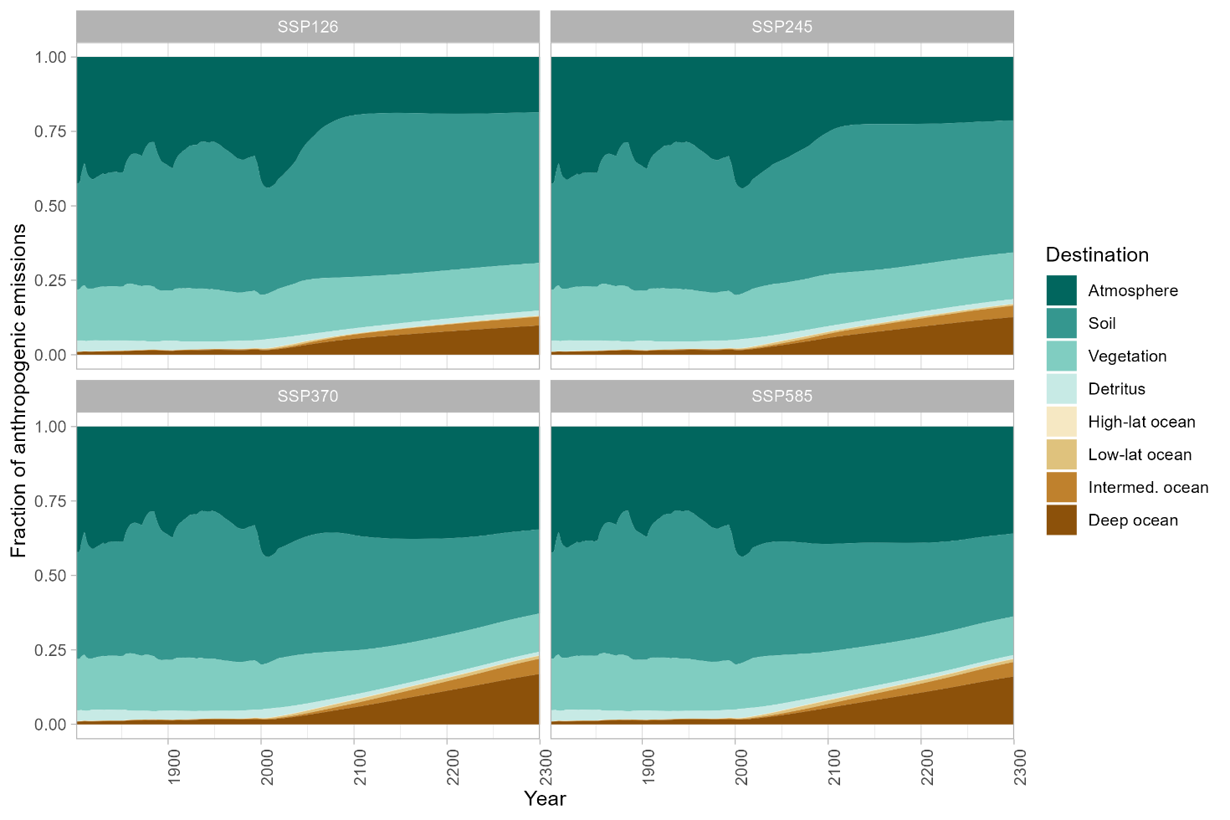
What Controls the Fate of Anthropogenic Carbon Dioxide?
Objective
Understand the long-term fate of anthropogenic CO₂ emissions, trace carbon pathways in the Earth system, and evaluate the robustness of current land and ocean carbon sinks.
Approach
Create random parameter draws from a priori probability density functions and perform a 15,000 run Monte Carlo simulation with the simple climate model Hector v3.0.
Filter results for physical realism and use variance partitioning to analyze controls on atmospheric CO₂.
Impact
Only a quarter of anthropogenic CO₂ emissions end up in the atmosphere, while, on centennial timescales, over half of CO₂ emissions were taken up by the land sink.
The land and ocean carbon sinks tended to have stable or increasing rates of CO₂ absorption over time.
By identifying emissions sources and sinks that are not differentiable by other methods, this study provides insights into the dynamics of anthropogenic CO₂ in the Earth system and highlights the importance this area for future work.
Hector v3.0’s carbon tracking feature allows the user to trace the flows of CO₂ as they move through the Earth system; this figure shows the destination of anthropogenic emissions over time for four emissions scenarios.
Pressburger, L., Dorheim, K., Keenan, T., McJeon, H., Smith, S., Bond-Lamberty, B. 2023. “Quantifying Airborne Fraction Trends and the Destination of Anthropogenic CO2 by Tracking Carbon Flows in a Simple Climate Model.” Environmental Research Letters, 18, 054005 (2023). [DOI: 10.1088/1748-9326/acca35]

