Slide 1
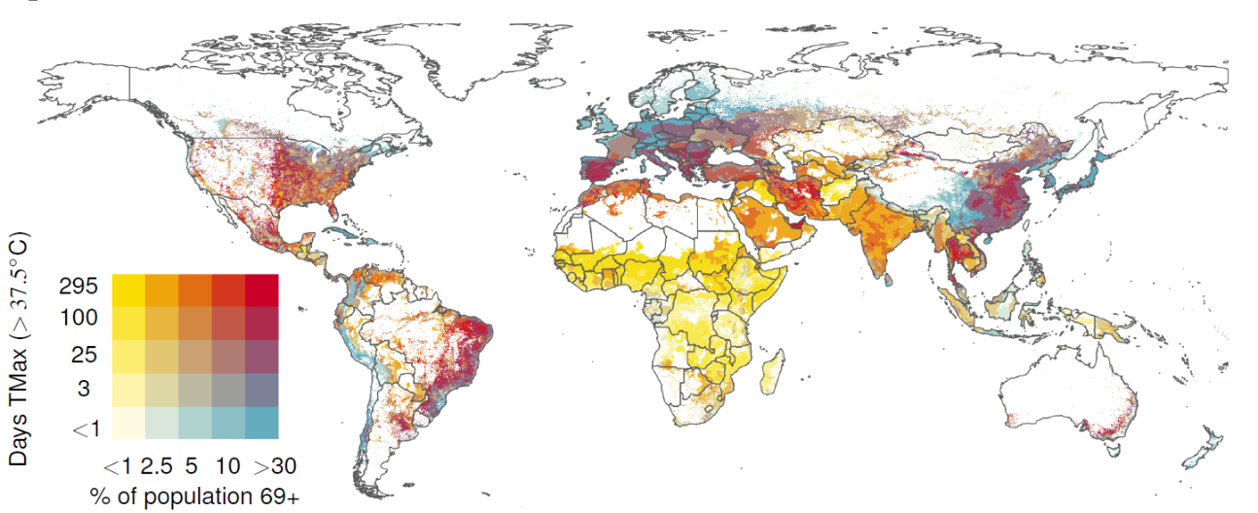
Global projections of heat exposure of older adults
Figure: The bivariate map describes the projected intersection around 2050 for scenario SSP5(85) between the share of older adults in the population and the exposure to hot days (count of days per year when the daily maximum temperature exceeds 37.5°C). Red areas identify regions with overlapping high shares of older adult in the population and high number of hot days.
Approach
We construct global gridded age-stratified demographic projections for different population scenarios and combine them with temperature projections from the the Coupled Model Intercomparison Project Phase 6 (CMIP6) downscaled, bias-corrected model output to quantify chronic exposure to high average temperatures and the frequency and intensity of acute exposure to extreme high temperatures for different age groups worldwide.
Impact
By 2050, > 23% of the global population aged 69+ will be exposed to dangerously high temperatures, up from 14% now, affecting an additional 177-246 million elderly people, particularly in Asia and Africa. Integrating climate change and healthy aging into adaptation planning and healthcare is critical. To inform policy, quantifying the cost and efficacy of active and passive cooling interventions—such as upgraded cooling technologies and expanded urban green spaces—in moderating morbidity and mortality should be investigated.
Objective
Coincident trends of population aging, and a warming climate portend the emergence of biologically and socially vulnerable “hotspots” around the world. It is crucial to geographically locate and quantify the level of exposure in different regions. Despite research confirming the individual-level effects of extreme heat on older adults’ health, we are unaware of comprehensive global-scale assessments of the future evolution of older adults’ heat exposures consistent with the shared socio-economic pathway (SSP) scenarios.
Falchetta G., Carr, D., E. De Cian and Sue Wing I. (2024). Aging in a warming world: global projections of cumulative and acute heat exposure of older adults. Nature Communications 15: 3678. https://doi.org/10.1038/s41467-024-47197-5

