Slide 1
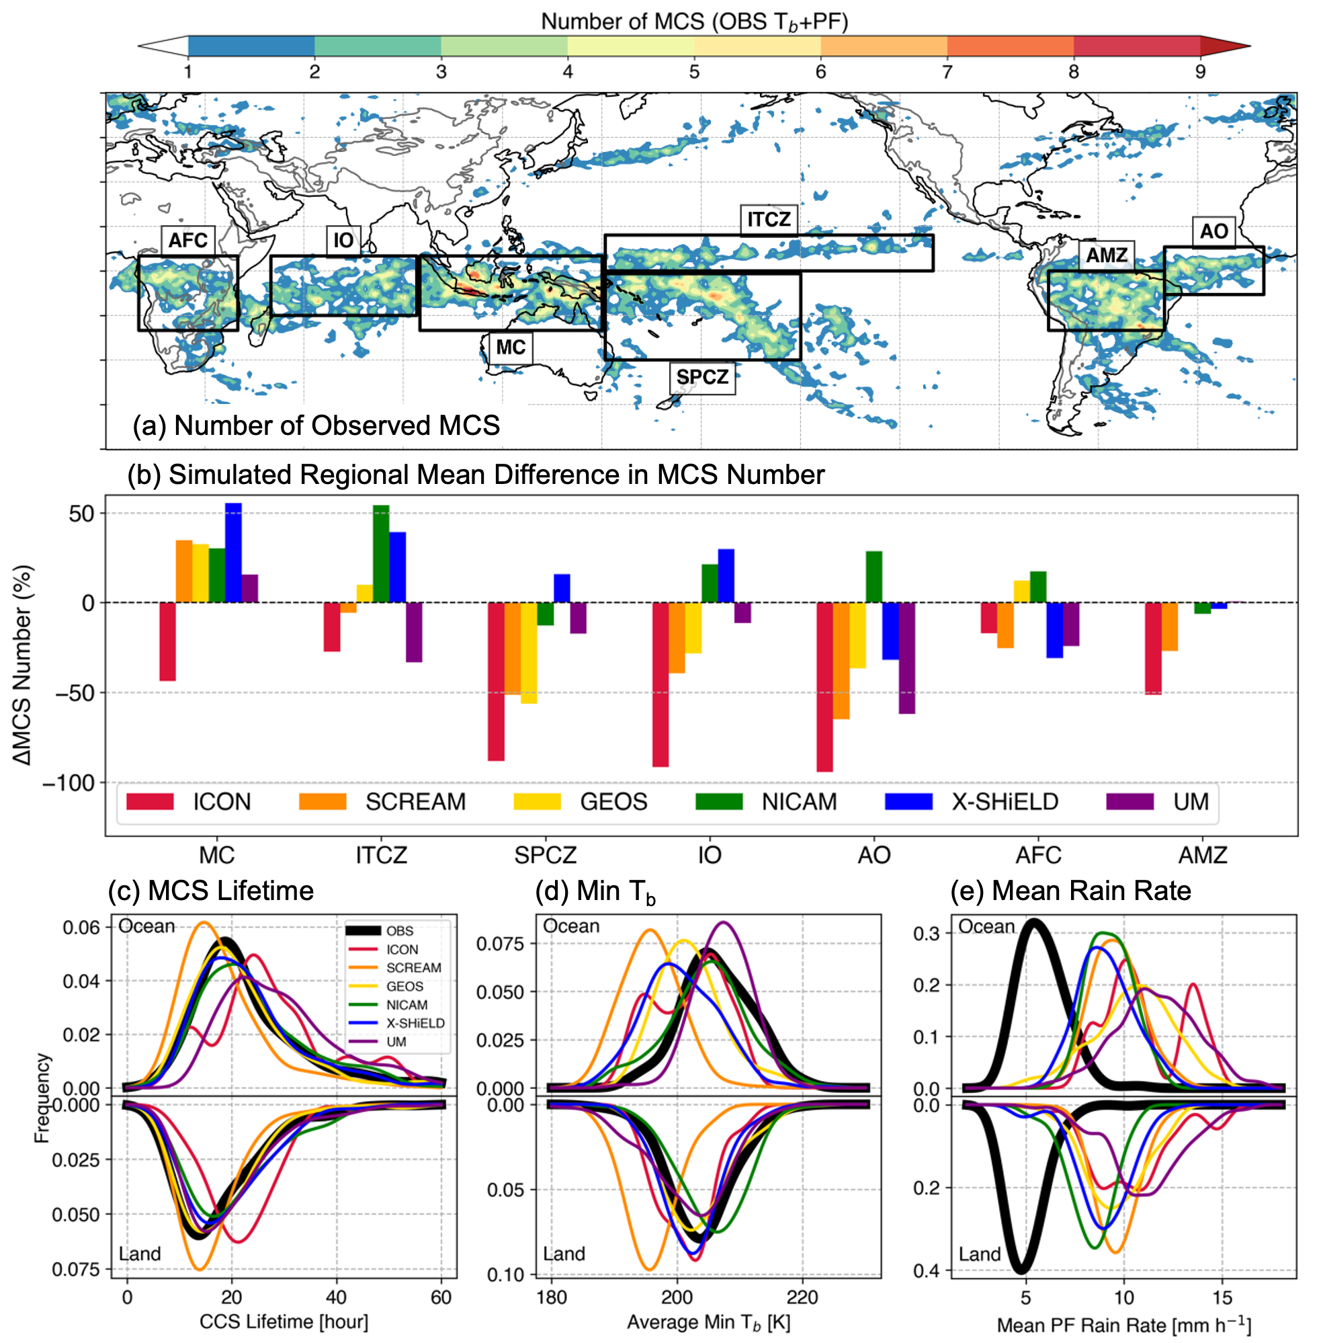
How Well Do Global Cloud-Resolving Models Simulate Mesoscale Storms?
Objective
Evaluate the realism of deep convection populations and mesoscale convective systems (MCSs) simulated by global cloud-resolving models through comparison with high-resolution satellite observations.
Approach
Track convective storms and identify MCSs in both global cloud-resolving models and high-resolution satellite observations.
Compare simulated and observed metrics including storm frequency, diurnal cycles, MCS characteristics, and rainfall intensity.
Impact
This is the first assessment of how an ensemble of global cloud-resolving models simulates isolated and organized convective storms.
The models produce a diverse range of values for the frequency of tropical deep convective storms and MCSs as well as their proportions in key climate regions.
While the models simulate the diurnal cycle of MCS initiation, MCS mature lifecycle stages, MCS lifetime, rainfall amount, and movement speed well, they overestimate convective rainfall intensity and underestimate the stratiform rainfall area.
Despite significant improvements compared to traditional global models at much coarser resolutions, challenges in simulating MCS remain in current state-of-the-art global cloud-resolving models motivating the need for further development.
Researchers compared MCSs between multiple global model simulations and satellite observations. (a) Observed MCS number, (b) simulated regional mean difference in MCS number, and probability distributions of MCS (c) lifetime, (d) minimum T_{b} (maximum cloud-top height), and (e) mean rainfall intensity.
Z. Feng, L.R. Leung, J. Hardin, C. R. Terai, F. Song, and P. Caldwell. “Mesoscale Convective Systems in DYAMOND Global Convection-Permitting Simulations”, Geophysical Research Letters, 50(4), e2022GL102603, (2023). [DOI:10.1029/2022GL102603]

