Slide 1
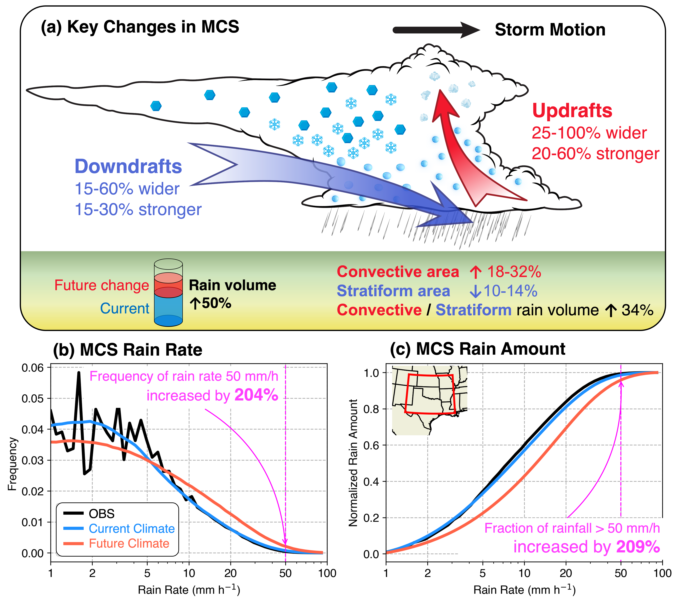
Climate Change May Triple the Intensity of Extreme Precipitation from Mesoscale Storms
Objective
Examine how clustered mesoscale convective systems (MCSs) exemplified by the May 2015 Texas/Oklahoma flood events may unfold in a warming climate, what are the underlying driving physical factors, and what are the implications for future flood risk?
Approach
Use a kilometer-scale regional model to simulate the event and evaluate the simulation against observations.
Model the effects of climate change by adding average warming signals projected by 12 global climate models under a high-emission scenario to the simulation.
Impact
Warming strengthens the Great Plains Low Level Jet to transport warmer and more unstable air that fuels stronger convective storms.
MCSs have wider and stronger updrafts, producing 50% larger rain volume and a three-fold increase in extreme (99.5%) MCS rainfall frequency and amount with warming.
Global warming greatly increases the precipitation intensity of clustered MCS events under strong synoptic influence, increasing the potential to produce serious floods without climate adaptation.
(a) Warming causes wider and stronger MCS updrafts and downdrafts that produce 50% larger rain volume and 34% increase in the convective vs. stratiform rain volume ratio, resulting in 204% increase in (b) the frequency of extreme MCS hourly rain intensity, and 209% increase in (c) the extreme MCS rainfall amount.
Z. Feng, X. Chen, and L. R. Leung. “How Might the May 2015 Flood in the U.S. Southern Great Plains Induced by Clustered MCSs Unfold in the Future?” Journal of Geophysical Research: Atmospheres, (2024). [DOI: 10.1029/2023JD039605]

