Slide 1
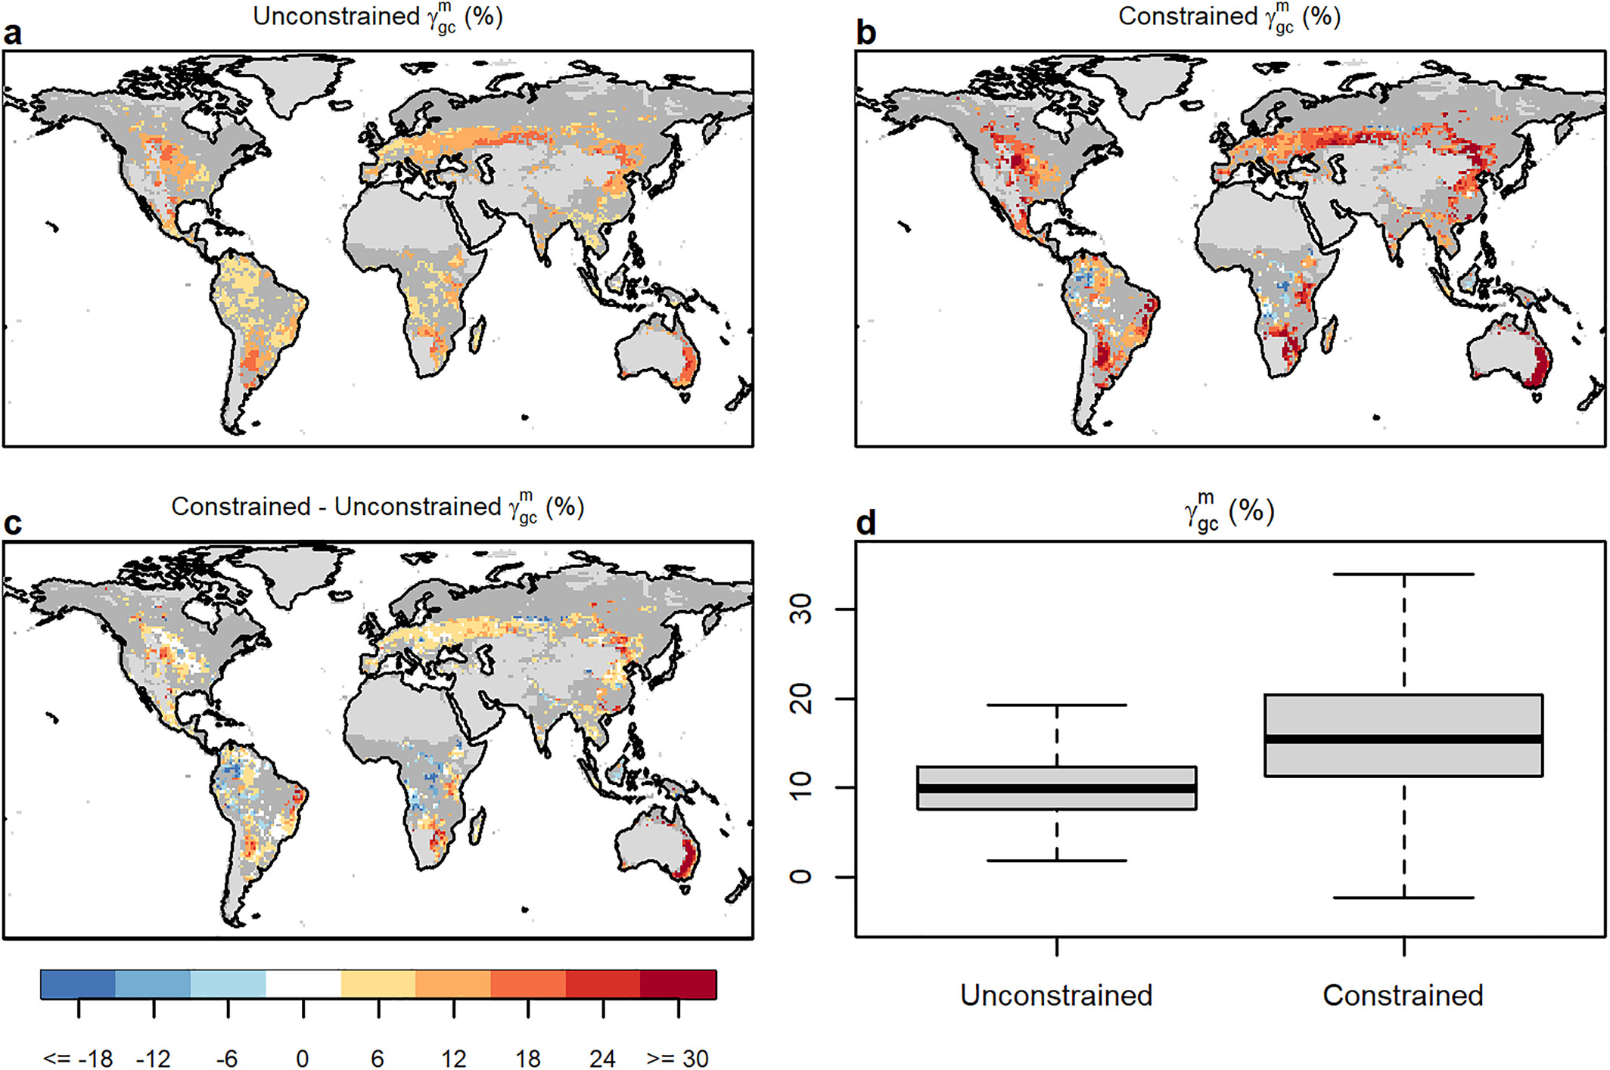

Systematic Underestimation of Canopy Conductance Sensitivity to Drought by Earth System Models
Scientific Achievement
We find that ESMs systematically underestimate sensitivity.
We show that this underestimation occurs because ESMs inadequately reduce gc when soil moisture decreases.
As gc controls carbon, water and energy fluxes, the misrepresentation of modeled sensitivity contributes to biases in ESM projections of gross primary production, transpiration, and temperature during droughts.
Significance and Impact
Our results suggest that the severity and duration of droughts may be misrepresented in ESMs due to the impact of sustained gc on both soil moisture dynamics and the biosphere-atmosphere feedbacks that affect local temperatures and regional weather patterns.
Fig. Canopy conductance sensitivity to changes in moisture availability. (a) The median unconstrained value of
across Coupled Model Intercomparison Project Phase 6 (CMIP6) Earth System Models (ESMs), (b) the median constrained value across CMIP6 ESMs. Light gray pixels are regions that were not analyzed due to the climatological leaf area index in observations never exceeding 1. Darker gray pixels are regions that were not analyzed because they did not have a significant relationships across the ensemble of ESMs at a p-value < 0.05.
Research Details
We leverage a collection of satellite, reanalysis and station-based near-surface air and surface temperature estimates to develop a novel emergent constraint of drought sensitivity in an ensemble of Earth System Models.
Green J et al. (2024), AGU Advances
DOI: https://doi.org/10.1029/2023AV001026

