Slide 1
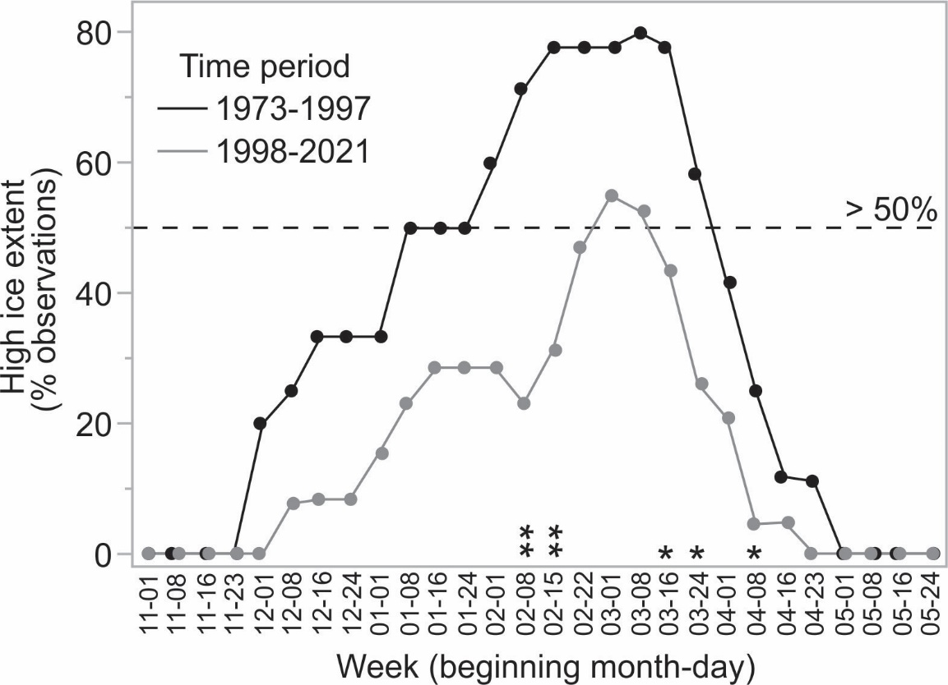
Long-term change and geospatial patterns of river ice cover and navigability
in Southcentral Alaska detected with remote sensing
Scientific Challenge
Our goal was to understand the long-term changes and local variation in the river ice cover and the impacts on winter travel and access to resources in the Copper River area of southcentral Alaska.
Approach and Findings
Using satellite remote sensing, we found large declines in weekly river ice extent related (53 percentage points) to increasing air temperatures over the last ~50 years. Spatial variation in reach-level hydrologic characteristics created a mosaic of ice conditions which differ in freeze-up timing, open water occurrence, and navigability.
Figure
Significance and Impact
Our study demonstrates the substantial impact of climate change on the seasonality of river ice and its negative effect on winter access. We differentiated potential winter river crossing areas from hazardous open water zones, and identified hydrologic drivers. The results of this study can support adaptation to changing ice conditions.
On a vulnerable 30-km reach of the Copper River, we found a much lower proportion of Landsat observations classified as “high ice extent” (that would enable river ice travel) in the more recent time period (1998-2021) throughout the winter. This reach does not reliably freeze-up anymore.
Brown, DRN, CD Arp, TJ Brinkman, BA Cellarius, M Engram, ME Miller & KV Spellman (2023) Long-term change and geospatial patterns of river ice cover and navigability in Southcentral Alaska detected with remote sensing, Arctic, Antarctic, and Alpine Research, 55:1, DOI: 10.1080/15230430.2023.2241279
Department of Energy • Office of Science • Biological and Environmental Research
Notes:
Word highlight text here.

