Slide 1
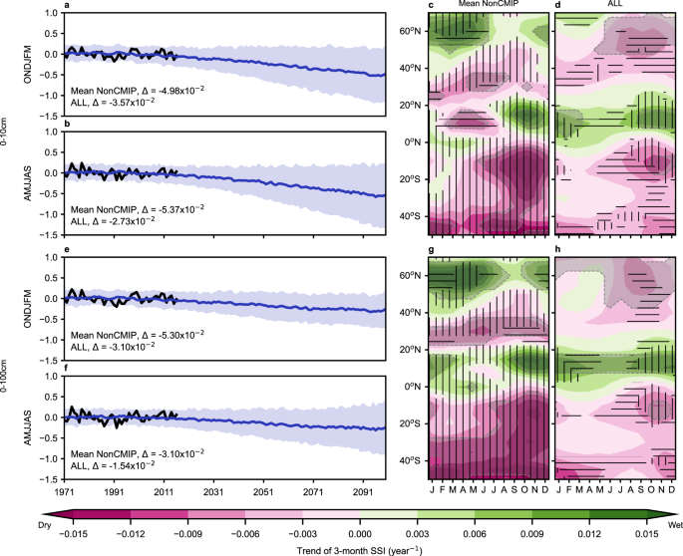
Quantification of Human Contribution to Soil Moisture-based Terrestrial Aridity
Objective: To detect, attribute and project the changes of global soil moisture-based terrestrial aridity.
Approach: Apply formal Detection&Attribution and emergent constrain methods onto latest merged soil moisture data and CMIP6 factorial simulations.
Results/Impacts: We identified widespread drying in the midlatitudes and wetting in the northern subtropics and in spring between 45°N–65°N, during 1971–2016. We found greenhouse gases contributed significantly to 0–10 cm droughts during August–November, and 0–100 cm during September–April. We further showed continued significant presence of human forcings and more rapid drying in 0–10 cm than 0–100 cm for the 21st century. The findings highlight predominant human contributions to spatiotemporally heterogenous aridification, providing a basis for drought and flood risk management.
.
Figure: Changes of 0-100cm Standardized Soil Moisture Index (SSI) for pseudo-observation (Mean NonCMIP) and ALL simulations (forced by all anthropogenic and natural forcing agents) for October–March (ONDJFM) and April–September (AMJJAS).
Wang, Y., Mao, J.*, Hoffman, F.M., Bonfils, C.J., Douville, H., Jin, M., Thornton, P.E., Ricciuto, D.M., Shi, X., Chen, H. and Wullschleger, S.D., 2022. Quantification of human contribution to soil moisture-based terrestrial aridity. Nature Communications, 13(1), pp.1-11.

