Slide 1
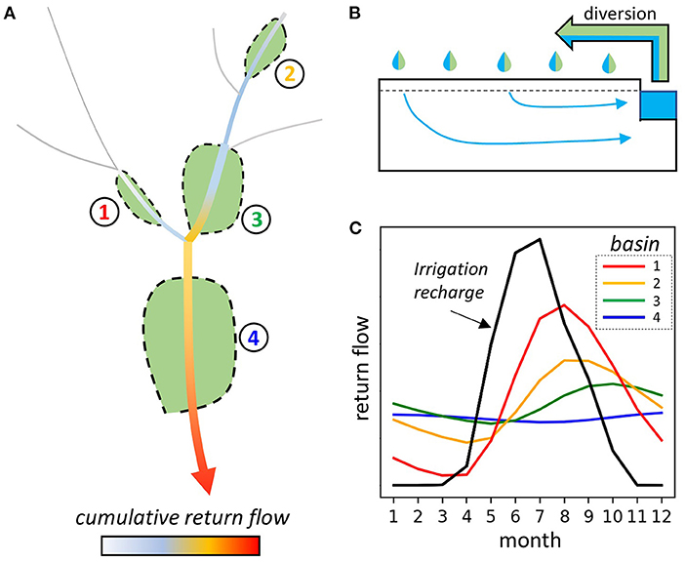
Exploring How Excess Irrigation Becomes Streamflow in Mountainous Watersheds
Objective
Use groundwater models to explore how site-specific factors affect the timing of irrigation return flows to better understand the accuracy of current return flow approximations used in water management models.
Approach
Incorporate observational data and modeling studies in western Colorado into groundwater models.
Simulate 360 parameter combinations at daily time scales over an 11-year period. Represented 10 years of typical irrigation rates and a hypothetical drought year in the eleventh year, when irrigation is reduced.
Compare monthly return flows from models to the analytical solution commonly used to estimate return flows.
Impact
Results show the risk of over-generalizing return flows over large model areas by not accounting for local conditions. Inaccurate estimates of when and how much additional water is provided by return flows may affect monthly water availability estimates.
Some aquifers can accumulate and store irrigation recharge over multiple years. Return flows from these aquifers can buffer water availability during drought years.
The modeling results showed a wide range in magnitudes and seasonal variability of return flows, with implications for both surface water availability and water quality.
(A) Return flows increase downstream with individual alluvial valleys contributing from lower to higher stream orders within a watershed. (B) Irrigation efficiency controls how much diverted water (shown by the arrow) becomes recharge (blue fraction). (C) Return flow timing and magnitude is controlled by local basin properties that affect the attenuation and delay of return flow discharge.
Ferencz, S.B., V.C., Tidwell. “Physical Controls on Irrigation Return Flow Contributions to Stream Flow in Irrigated Alluvial Valleys,” Front. Water 4, 828099 (2022). [DOI: 10.3389/frwa.2022.828099]

