Slide 1
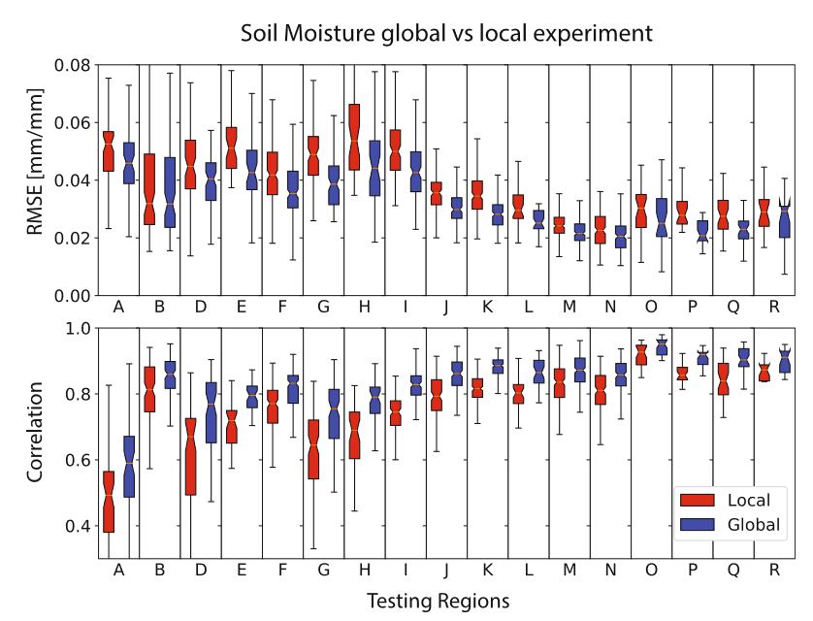
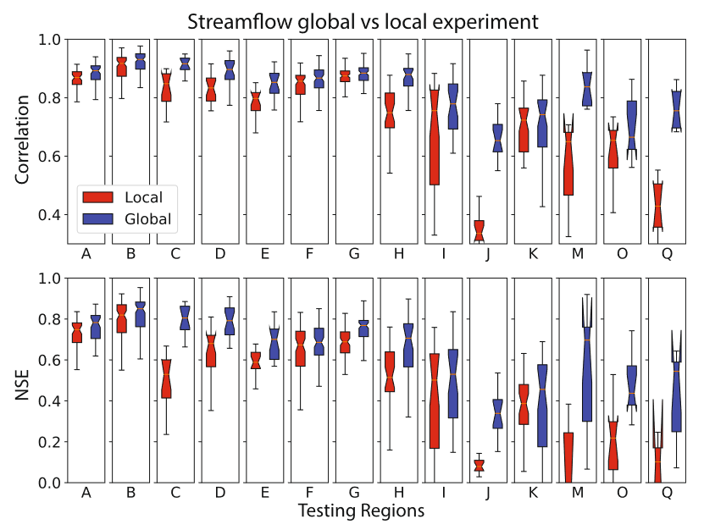
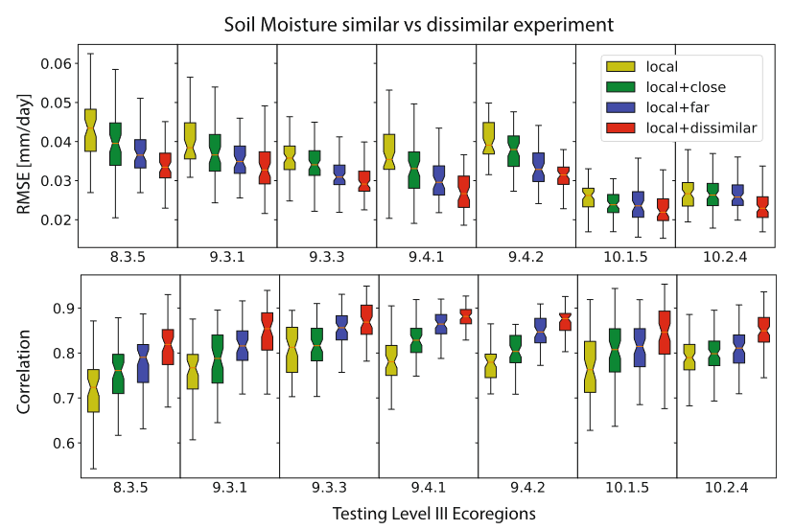
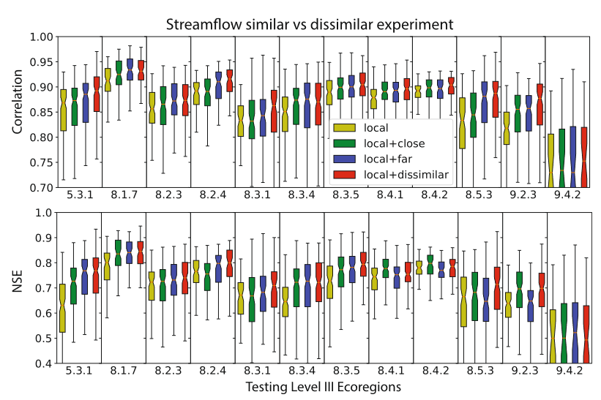
The Data Synergy Effects of Time-Series Deep Learning Models in Hydrology
(a)
(b)
Objectives
Demonstrate the effect of data synergy with time-series deep learning models in hydrology for 1) satellite-observed soil moisture and 2) streamflow measured at basin outlets.
Evaluate predictions from both local (trained using data only from inside the respective region), and global (trained using more heterogeneous data that include the study region and data from more distant regions) models in various regions of interest.
Determine whether for these applications, if global models are better than local models
Determine whether deep learning models benefit from the diversity of this training data, or simply the increased quantity of training data, or both
(c)
(d)
Figures: Top panels are global vs. local experiment results of correlation and error metrics for (a) soil moisture and (b) streamflow. Bottom panels are similar vs. dissimilar experiment results for (c) soil moisture and (d) streamflow
Conclusions
We introduced data synergy, where deep learning performance in a local region improves when including samples from other regions
Data synergy is apparent with modestly diverse training data, partly because a larger and more diverse data set contains more extreme events
This work highlighted the value of samples outside a region of interest, emphasizing the need for community data sharing
Fang, K., Kifer, D., Lawson, K., Feng, D., & Shen, C. (2022). The data synergy effects of time-series deep learning models in hydrology. Water Resources Research, 58(4), e2021WR029583. https://doi.org/10.1029/2021WR029583

