Slide 1
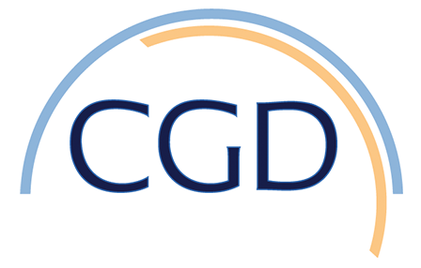
Coupled insights from the palaeoenvironmental, historical and archaeological archives to support social-ecological resilience and the sustainable development goals
Objective: Many governments and organisations are currently aligning many aspects of their policies and practices to the sustainable development goals (SDGs). Achieving the SDGs should increase social-ecological resilience to shocks like climate change and its impacts. Here, we consider the relationship amongst the three elements—the SDGs, social-ecological resilience and climate change—as a positive feedback loop. We argue that long-term memory encoded in historical, archaeological and related ‘palaeo-data’ is central to understanding each of these elements of the feedback loop, especially when long-term fluctuations are inherent in social ecological systems and their responses to abrupt change.
Approach: Analyzing paleo-data and modern sustainable development goals
Results/Impacts: In conclusion, we highlight four key messages: (1) The relationship amongst climate change, the SDGs and resilience can be broadly considered a positive feedback loop. To achieve progress towards the resilience, we need to travel in a clockwise direction. (2) Variability and change over long time frames are inherent in natural, and human, systems. It is therefore essential to incorporate the information from the wealth of palaeo-records available into frameworks purporting to measure progress towards resilience. (3) Analysis of historical and archaeological records over long time spans and in relation to specific events is critical to informing policies that aim to increase our resilience to the accumulating impacts of change. (4) We need to very carefully assess what records of the past tell us about the potential conflict between planetary and some social goals. Where long-term records indicate persistent clashes in objectives, we need to be sufficiently bold to robustly address these challenges in order to avoid promoting an anti-clockwise journey around the feedback loop.
Figure 1. Simplified positive feedback loop between the sustainable development goals framework, social-ecological resilience and climate change. Contributions of historical, archaeological and paleo-data are central to understanding past environmental change, including responses to climate change and social-ecological resilience. Palaeo-data can also provide input into developing suitable indicators for some targets. If proceeding in a clockwise direction (red line), achieving the SDGs should enhance social-ecological resilience which then supports action on climate change and limitation of warming which then enhances the ability to achieve the SDGs. However, an anticlockwise (purple line) direction indicates that progress towards the SDGs falters which then negatively impacts on social-ecological resilience and impairs the ability to limit anthropogenic climate change. Escalating changes and reaching tipping points further undermines the ability to achieve the SDGs.
Allen, K. J., F. Riede, C. Gouramanis, B. Keenan, M. Stoffel, A. Hu, M. Ionita, 2022, Coupled insights from palaeoenvironmental, historical and archaeological archives to support social-ecological resilience and the Sustainable Development Goals, Environmental Research Letter,
17, 055011.

