Slide 1
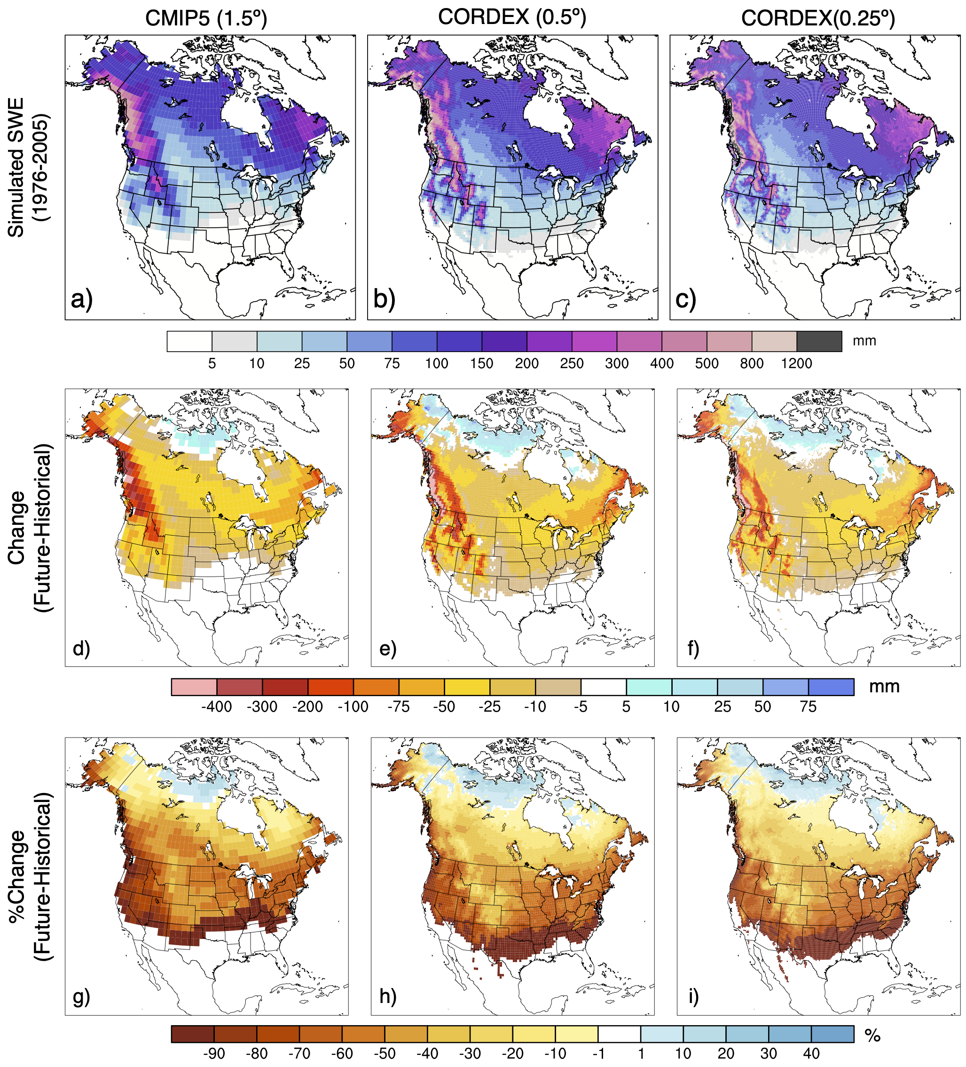
Projections of North American Snow from NA-CORDEX
Objective
In a warming climate, the characteristic of snow will likely change in fundamental ways, therefore compelling societal need for projections of snow. However, many stakeholders require climate change information at finer scales than GCMs can provide. The North American Coordinated Regional Downscaling Experiment (NA-CORDEX) provides an ensemble of regional climate model (RCM) simulations at ~0.5º and 0.25º. This study examines differences in end-of-century projections of snow with an eye toward the role that model resolution plays in the climate change response and uncertainty.
Approach
We consider three climate model ensembles 1) NA-CORDEX driving GCMs, 1) NA-CORDEX 0.5º simulations, and 3) NA-CORDEX 0.25º simulations. We first evaluate against an observational ensemble to assess bias. We then examine continental changes in snow cover extent, snow water equivalent, and snow cover duration over North American and within 3 sub-basins, the Northeast, Northern Canada, and the Intermountain West.
Impact
This work demonstrates that the broad patterns of change are similar across the RCMs and GCMs: snow cover retreats, snow mass decreases, duration of snow cover season decreases. But the spatial detail, magnitude, percent and uncertainty of the change varies between the GCMs and RCMs, but not between the RCMs with different resolutions.
Figure. Maps of average annual monthly maximum snow water equivalent (SWE) from the NA-CORDEX GCMs and RCMs (top). Magnitude (middle) and percent (bottom) end-of-century change in annual monthly maximum SWE.
McCrary, R.,L. Mearns, M. Hughes, S. Biner, M. Bukovsky (2022): Projections of North American Snow from NA-CORDEX and their Uncertainties, with a Focus on Model Resolution. Climatic Change , 170(20). https://doi.org/10.1007/s10584-021-03294-8

