Slide 1
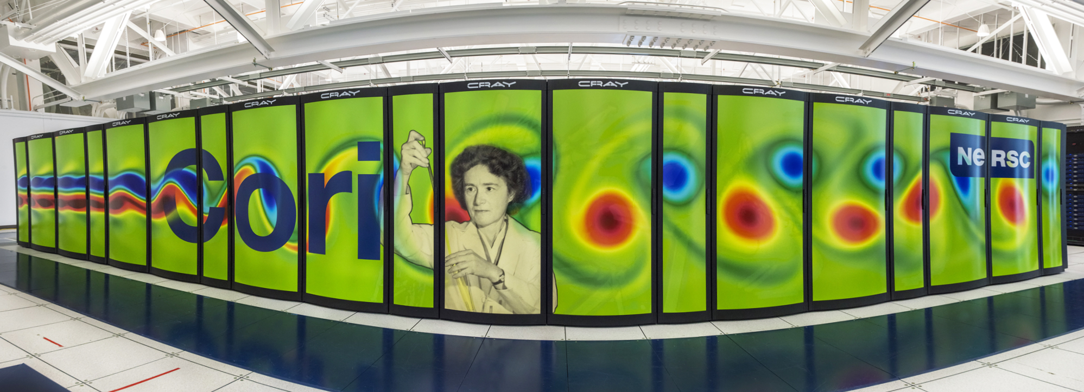
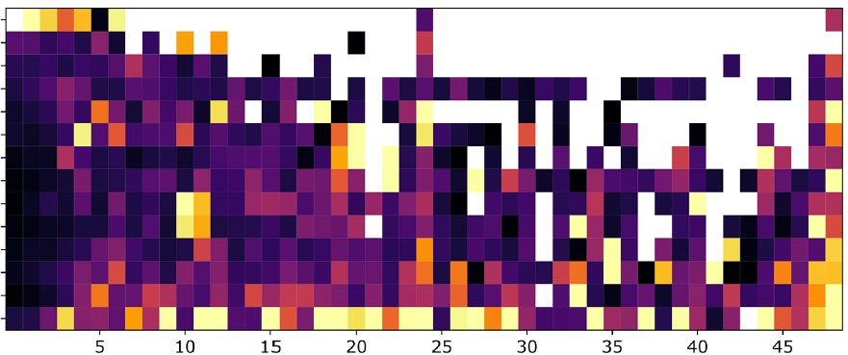
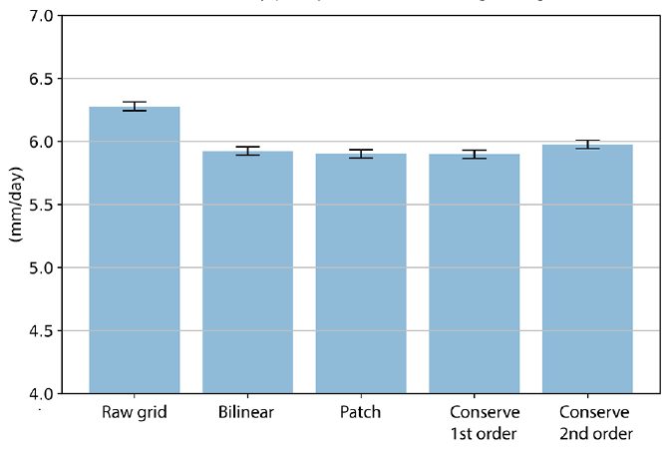
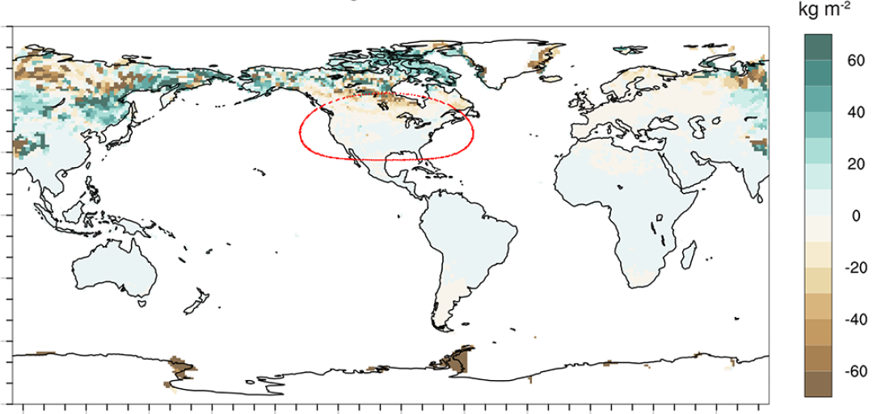
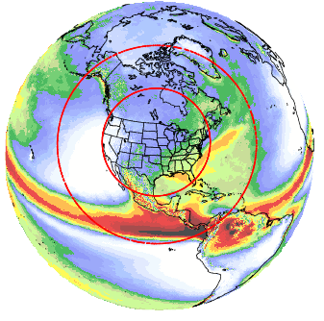
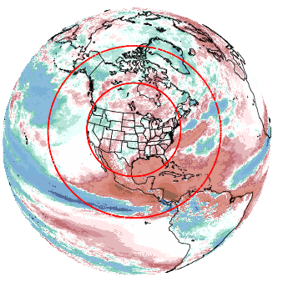
From Supercomputers to Regional Climate Data: Exploring Best Practices for “Variable-Resolution” Modeling
Objective
Document the technical details and uncertainty sources for dynamically downscaled regional climate projections from a global variable-resolution (VR) model.
Approach
Conduct downscaling experiments using a global VR model, the Model for Prediction Across Scales coupled to the Community Atmosphere Model (CAM-MPAS), following the protocol for the North American Coordinated Regional Downscaling Experiment.
Evaluate the quality of the simulated climate, computational model performance, and data-processing impact on climate statistics.
Impact
Global VR models have not been fully evaluated in the context of dynamical downscaling. This research found important factors in regional climate projections by VR models, including:
The climate state outside the target downscaling region, which can help avoid unrealistic teleconnection effects (e.g., tropical oceans where model resolution-sensitivity is high and cold regions where soil ice takes years to equilibrate).
Workflow efficiency, as the higher computational demands of VR downscaling require a more efficient workflow than regional models. Model codes should be optimized for the latest architectures. Users should configure the model for shorter waits, faster computation, and lower resource cost. Limited attention to these factors reduces simulation lengths/ensemble sizes and increases sampling uncertainty.
(a)
photo credit:
Lawrence Berkeley National Laboratory
8,000
(b)
(c)
3,000
700
200
50
10
5
1
hours
(d)
(e)
Historical
Future change
Aspects of the VR downscaling workflow assessed in this study: (a) the Cori supercomputer; (b) the average queue wait time (hours) on Cori; (c) the effect of regridding on precipitation variability by different algorithms; (d) the non-equilibrium state of soil ice outside of North America; and (e) historical and future projections of precipitation.
Sakaguchi, K., L. R. Leung, C. M. Zarzycki, J. Jang, S. McGinnis, B. E. Harrop, et al. “Technical descriptions of the experimental dynamical downscaling simulations over North America by the CAM–MPAS variable-resolution model.” Geoscientific Model Development, 16(10), 3029–3081 (2023). [DOI: 10.5194/gmd-16-3029-2023]
Notes:
http://www.pnnl.gov/science/highlights/highlights.asp?division=749

