Slide 1
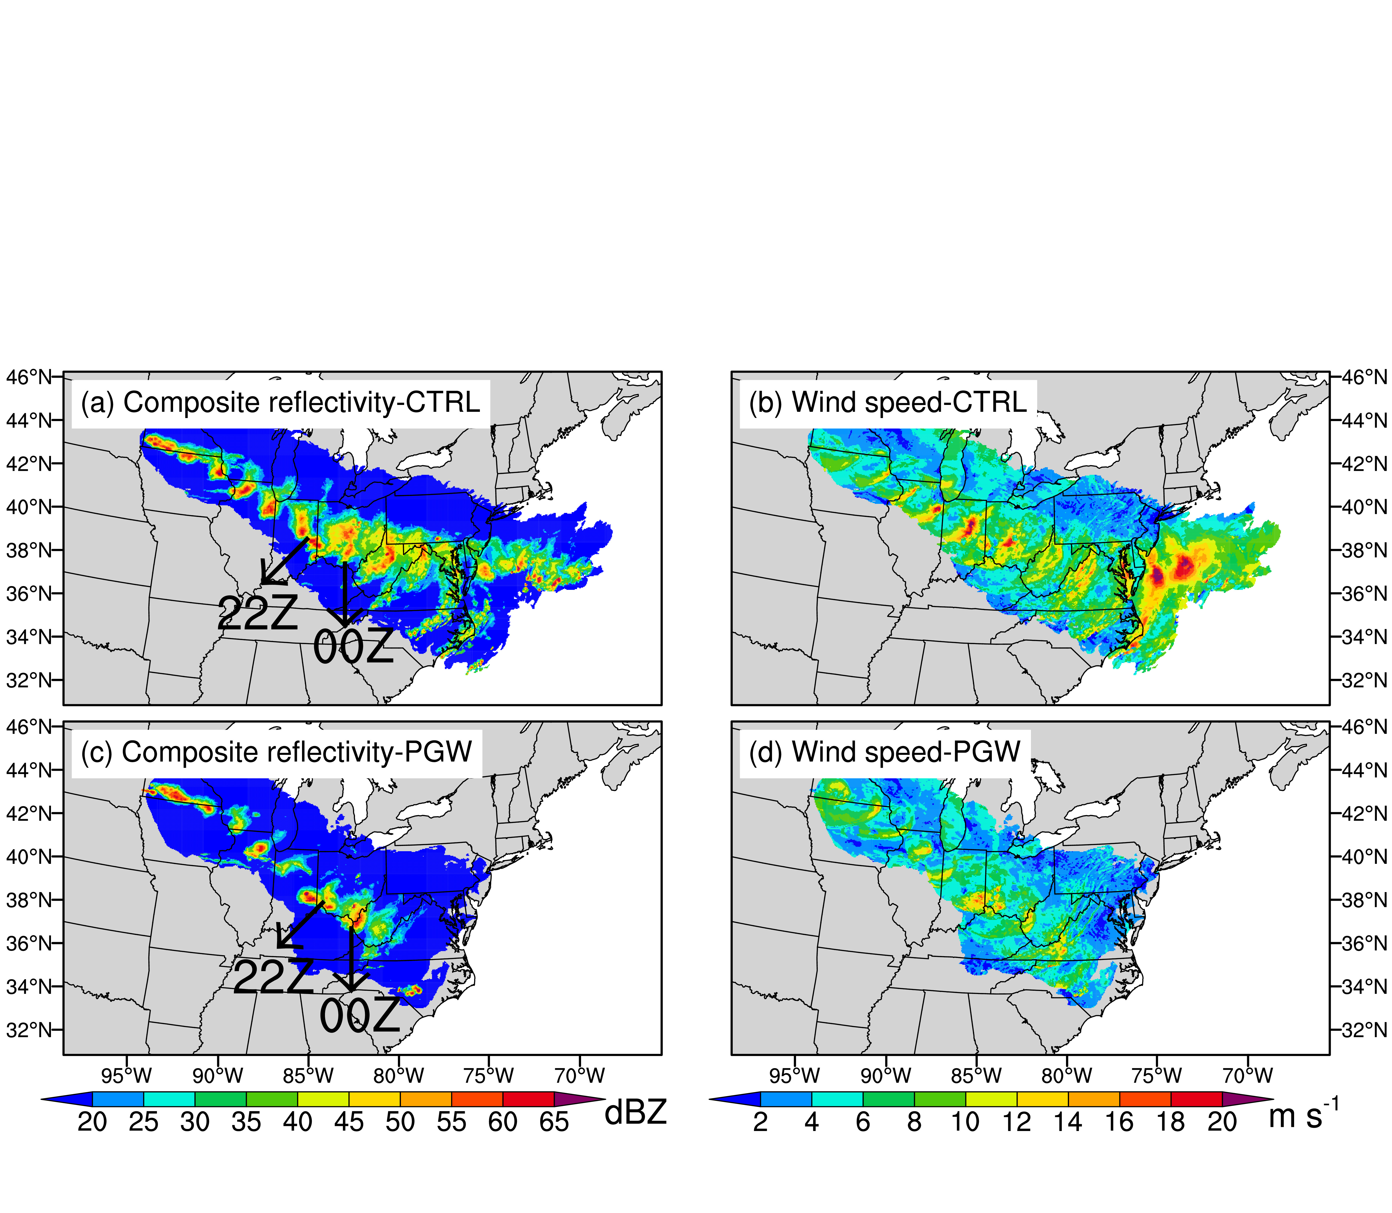
Warming Weakens the June 2012 North American Derecho
Objective
Investigate how the June 2012 North American derecho could unfold in a warmer climate.
Approach
Compare convection-permitting Weather Research and Forecasting (WRF) model simulations of the derecho under real conditions (CTRL) with simulations under a pseudo-global warming scenario (PGW) of the future environments by the end of the 21st century following the Shared Socioeconomic Pathways (SSP5-8.5).
Track the derecho and its associated characteristics in the WRF simulations using the updated Flexible Object Tracker algorithm.
Analyze changes in the thermodynamic environment to understand differences in the derecho under future warming.
Impact
Revealed how warming-related changes in the thermodynamic environment could induce complex alterations to the June 2012 North American derecho.
Corroborated the importance of near surface relative humidity changes in modulating convective storm characteristics.
Highlighted the importance of performing a detailed analysis to identify and understand the mechanisms that lead to changes in derecho simulations.
Derecho evolutions based on radar signature (left) and surface wind speed (right) averaged over an ensemble of the CTRL (top) and PGW (bottom) simulations.
In the PGW simulations, the derecho shrinks in the first half of its lifecycle and decays earlier, producing less extreme weather conditions (heavy precipitation and gale wind).
J. Li, Y. Qian, L. R. Leung, X. Chen, Z. Yang, and Z. Feng. “Potential weakening of the June 2012 North American derecho under future warming conditions.” Journal of Geophysical Research: Atmospheres, 128, e2022JD037494, (2023). [DOI: 10.1029/2022JD037494].

