Slide 1
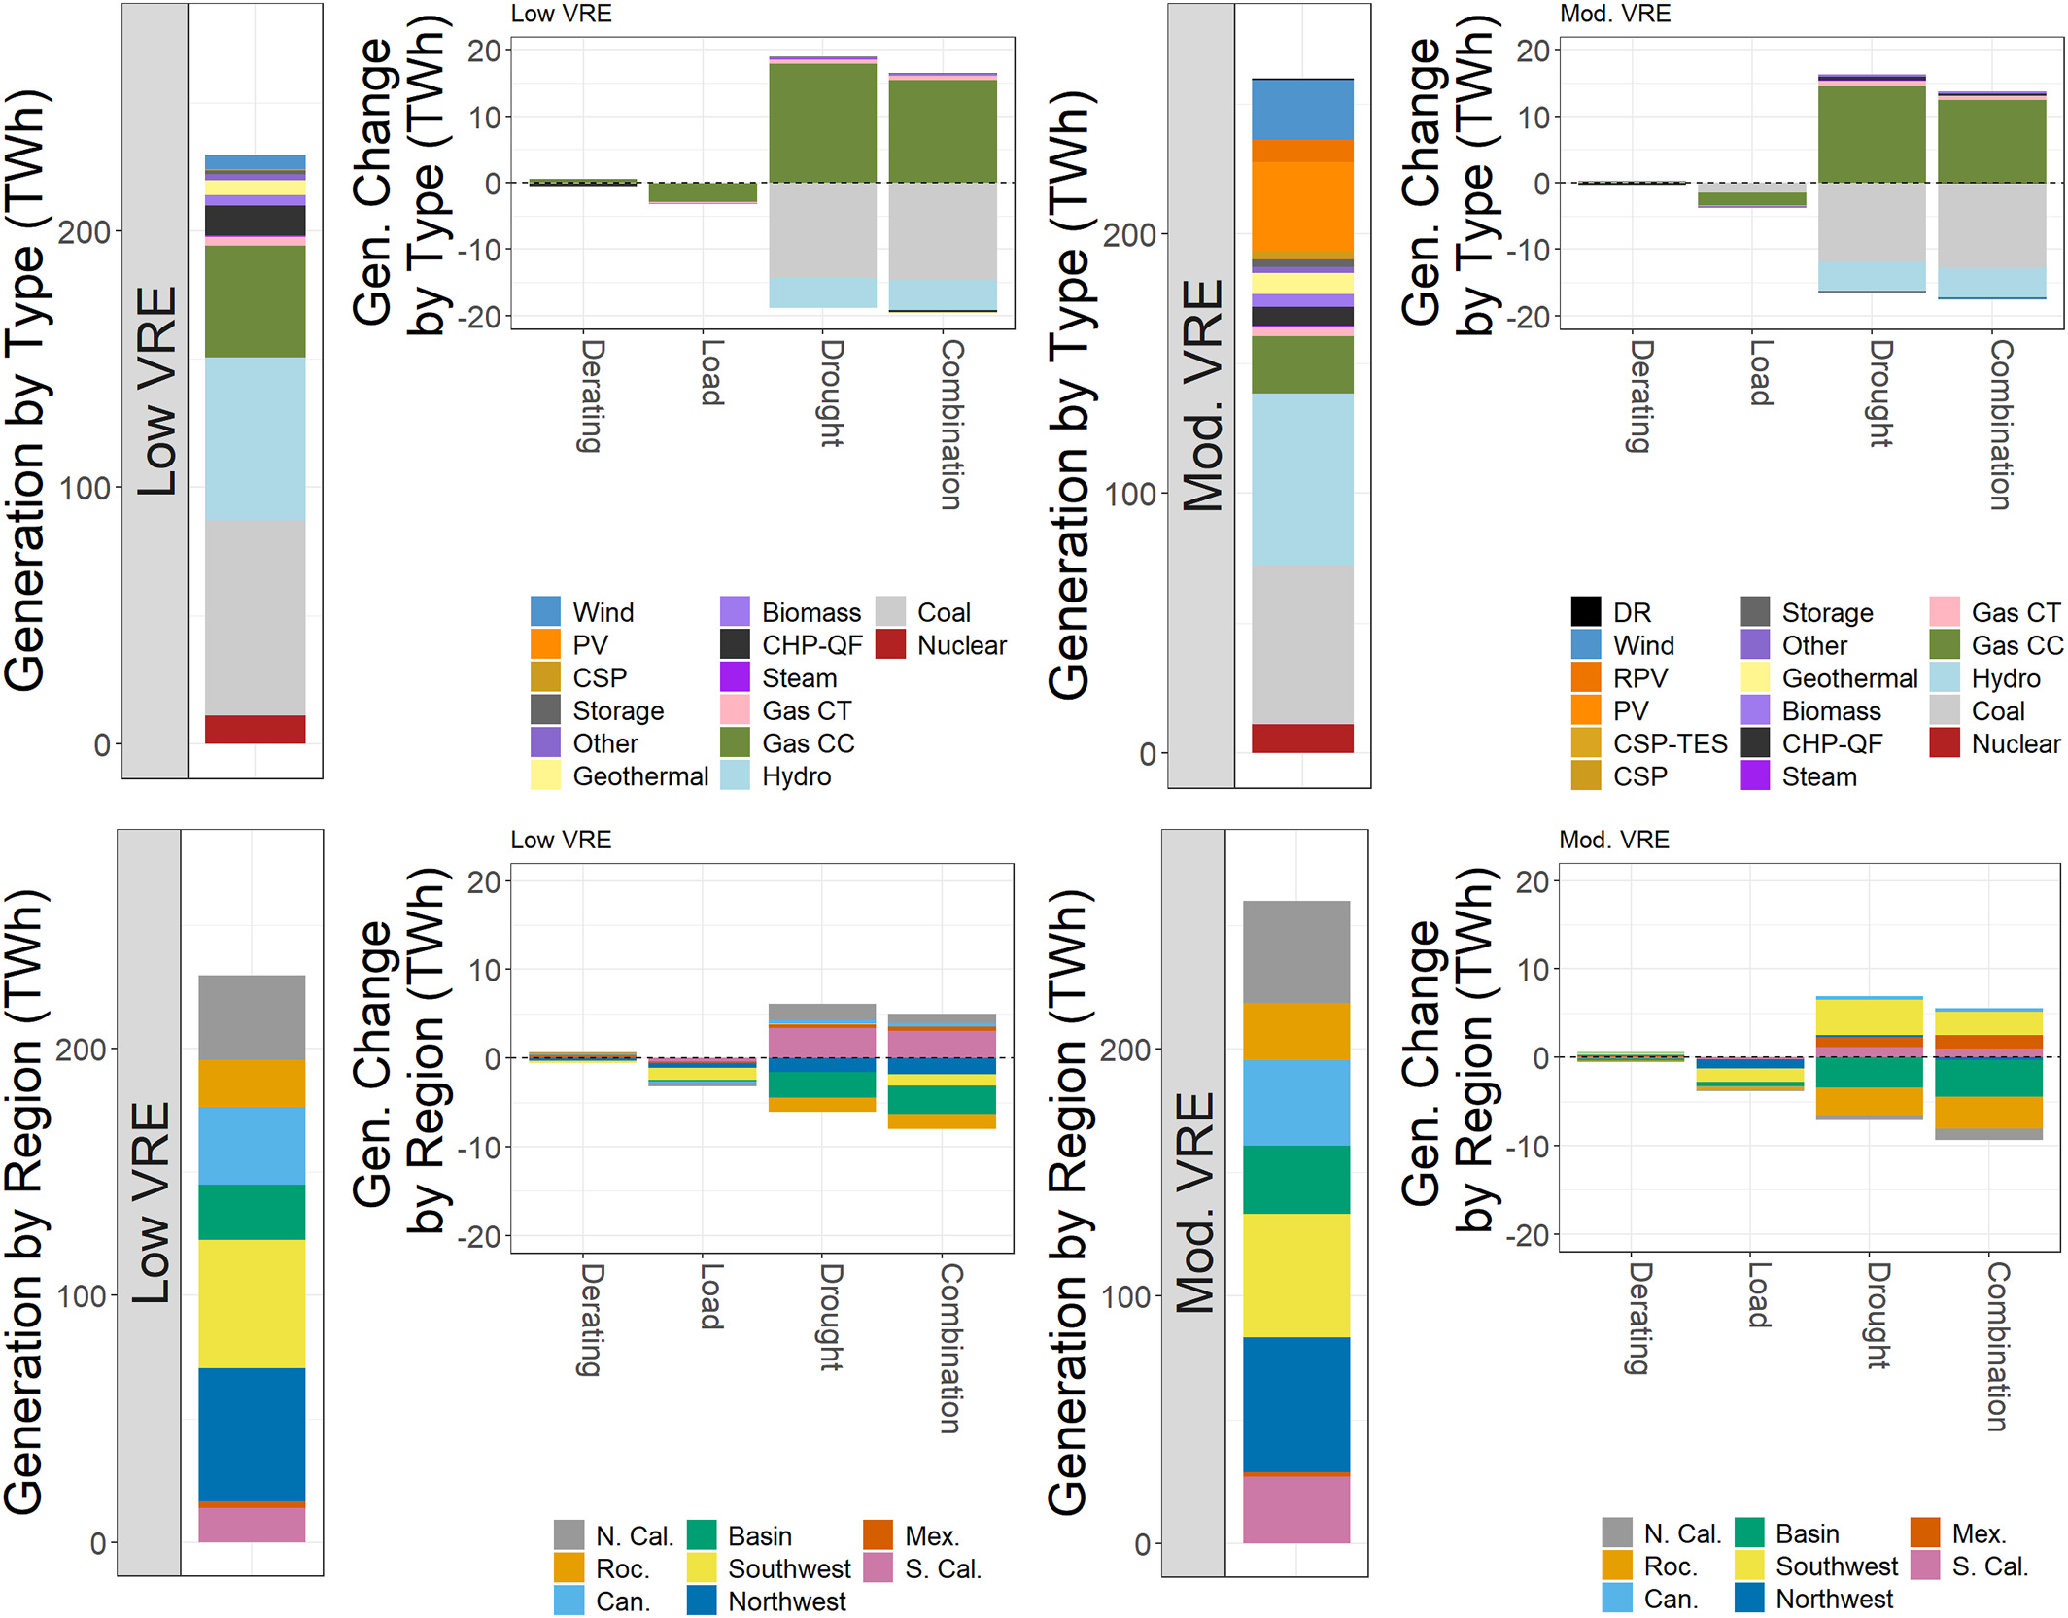
Planning Future Power Systems Under Climate Extremes
Objective
This study investigates the effects of temperature and drought extremes on the Western U.S. power grid, while taking into account the increasing penetration of variable renewable energy sources, using a high-resolution operational power system model.
Approach
Evaluated contemporary and hypothesized Western U.S. infrastructures with 5% and 31% variable renewable generation shares for sensitivity to drought and Southern California heat wave scenarios on generation and load.
Used a stochastic temperature simulation combined with spatially resolved historical drought as a toolset to incorporate other grid stressors in high-resolution power system models, leading to improved sensitivity analyses not limited by the current ability of climate models to capture extreme conditions.
Impact
Highlights the need to consider regional connectedness in planning for extreme events and that this need may persist with increasing penetration of variable renewable energy resources.
Emphasizes the importance of modeling water-based grid stress and extreme electricity demand scenarios with high-resolution power system models for a risk-based approach to planning for extreme events.
Impacts of climate extremes on total summer generation by type and region for low and high variable renewable energy (VRE) systems.
Dyreson A., N. Devineni, S. Turner, T. De Silva, A. Miara, N. Voisin, and S. Cohen, et al. (2022). "The Role of Regional Connections in Planning for Future Power System Operations under Climate Extremes." Earth's Future, 10(6):e2021EF002554.
DOI:10.1029/2021EF002554

