Slide 1
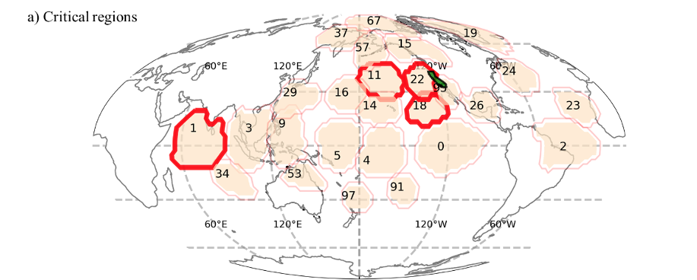
Wetter California projected by CMIP6 models with observational constraints under a high GHG emission scenario
Scientific Challenges
California (CA) is vulnerable to climate changes, especially the magnitude of winter (wet season) precipitation
CMIP6 models projected wide ranges of precipitation changes over California, with no agreement on the sign of changes
Approach and Results
We combined Pareto optimality and observed teleconnection patterns to estimate future changes of precipitation over CA
California precipitation will increase by 10% - 34% and 7% - 32% over northern and southern regions by the end of the 21st century
Figure. Critical regions where sea level pressure (SLP) significantly affects California precipitation. We used these observed teleconnection patterns (causal relationships between ocean regions and California precipitation) to mechanistically constrain CMIP6 projected CA precipitation.
Significance
Up to 71% of ESM projection uncertainties were reduced using the strong causal relationship between North American west coast sea level pressure and CA precipitation in both observations and CMIP6 models
Our results suggest that teleconnection patterns are powerful mechanistic constraints that can help explain and reduce uncertainties in ESM projections
F. Li, Q. Zhu, W.J. Riley, K. Yuan, H. Wu, Z. Gui. "Wetter California projected by CMIP6 models with observational constraints under a high GHG emission scenario." Earth's Future (2022): e2022EF002694, DOI: 10.1029/2022EF002694

