Slide 1
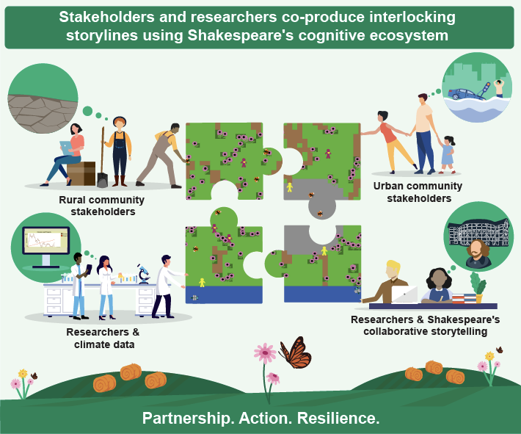
Mind the gaps! Climate scientists should heed lessons in collaborative storytelling from William Shakespeare
Scientific Challenge
Community partners involved in co-producing climate information with climate scientists bring diverse knowledges, values, and perspectives. Engaging the full scope of their contributions is vital for obtaining successful, equitable responses to climate change.
Approach and Findings
Evocative tools that prompt partners to tell their weather and climate stories opens gateways for understanding diverse needs and interests. The “cognitive ecology” that emerges from sharing stories enables intuitive recognition of all partners’ knowledge, values, and perspectives.
Figure
Significance and Impact
We combine principles from emerging climate “storylines” research with collaborative storytelling inspired by William Shakespeare’s theatrical practices. Shakespeare leaves gaps in his plays’ narratives that spark collaborations and multiple interpretations. These gaps allow others to enter as collaborators, creating a collective understanding, termed a “cognitive ecosystem”, that expands each other’s thinking, fostering knowledge and cohesive action among all. Integrating these methods into climate storyline-making offers a radical paradigm: it upends the scientist’s role as the focal storyteller and expert, and fosters, instead, partnership, equity, and a co-exploration of multiple uncertainties. It is time for researchers to promote a cognitive ecosystem of collaborative action.
Inspired by Shakespeare, researchers and stakeholders co-create storylines in a cognitive ecosystem of collective understanding.
Shenk, L., and W. J. Gutowski, 2022: Mind the gaps! Climate scientists should heed lessons in collaborative storytelling from William Shakespeare. WIREs Climate Change, https://doi.org/10.1002/wcc.783.
Biological and Environmental Research
Notes:
Word highlight text here.

